Slide 1



#StrongerTogether:
SSAH and the future of evidence-informed policymaking
DAY 1
#StrongerTogether: SSAH

Slide 2
Introductory Plenary Session
09:15-09:30

Slide 3
Director General Research and Space at Belgian Science Policy Office (BELSPO)
Frank Monteny

Slide 4
Director General DG Research and Innovation (RTD) of the European Commission
Marc Lemaître

Slide 5
Sven Retoré
09:30-11:05
Plenary Opening Session:
The actors of the evidence-informed policymaking ecosystem and their views on its functioning

Slide 6
Minister of social affairs and health
Frank Vandenbroucke
The viewpoint of a policymaker on the EIPM ecosystem

Slide 7
Vice-rector of research and valorisation, Université Libre de Bruxelles; former member of GEES (advisory panel to the Belgian government during the pandemic)
Professor Marius Gilbert
The viewpoint of a scientist on the EIPM ecosystem

Slide 8
Member of the Group of Chief Scientific Advisors, Scientific Advice Mechanism to the European Commission
Professor Eric Lambin
The viewpoint of a knowledge broker on the EIPM ecosystem

Slide 9
Director for Innovation in Science & Policymaking, Joint Research Center of the European Commission
Jolita Butkeviciene
The viewpoint of a knowledge broker on the EIPM ecosystem

Slide 10
Chief Editor of The Conversation France
Fabrice Rousselot
The viewpoint of a journalist on the EIPM ecosystem

Slide 11
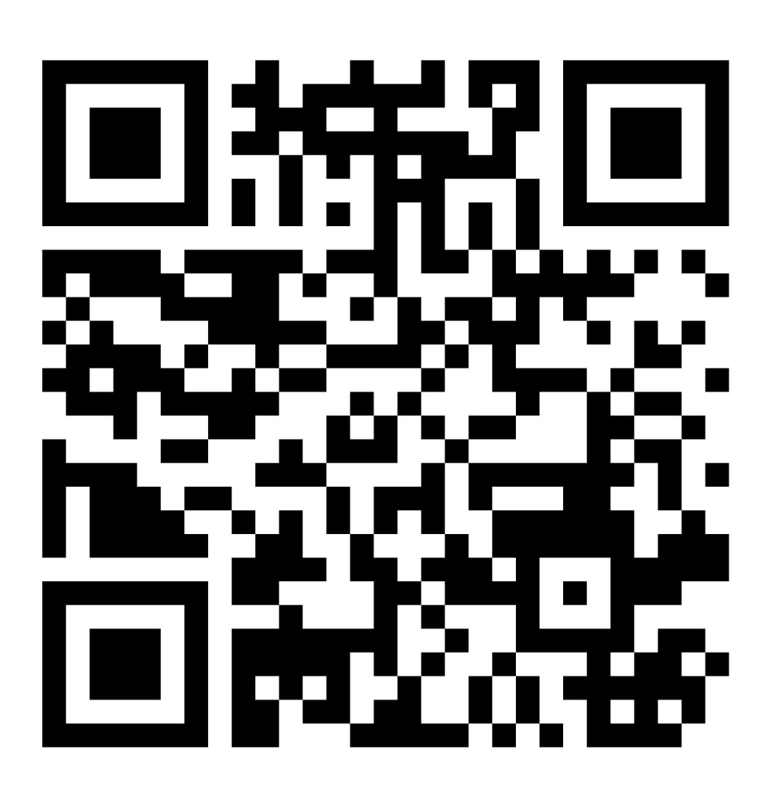
Go to: Menti.com
Code: 4733 8379

Slide 12
Sven Retoré
11:30-12:40
Macroscopic views on the functioning of the evidence-informed policymaking ecosystem

Slide 13
Senior adviser, OECD
Stéphane Jacobzone
Behavioural and institutional dimensions in the functioning of the actors in the EIPM ecosystem
Notes:
Not approved for publishing yet

Slide 14
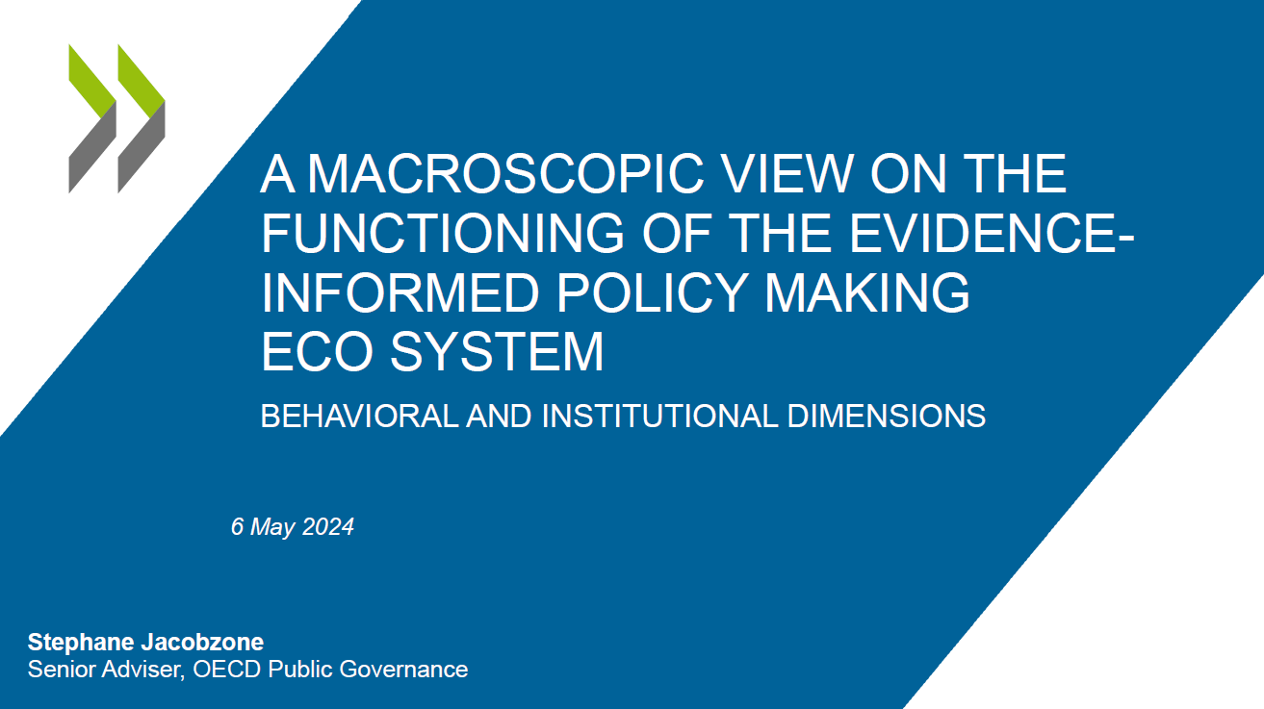


Slide 15
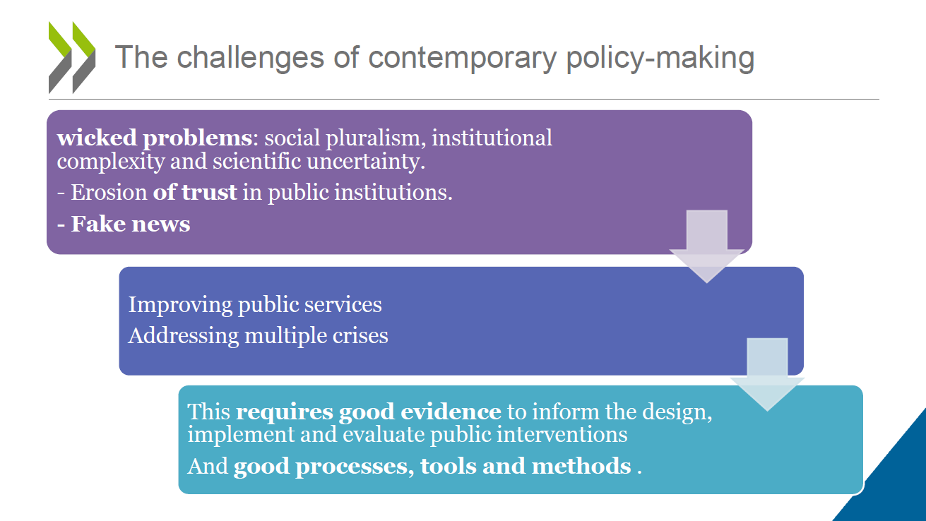

Slide 16
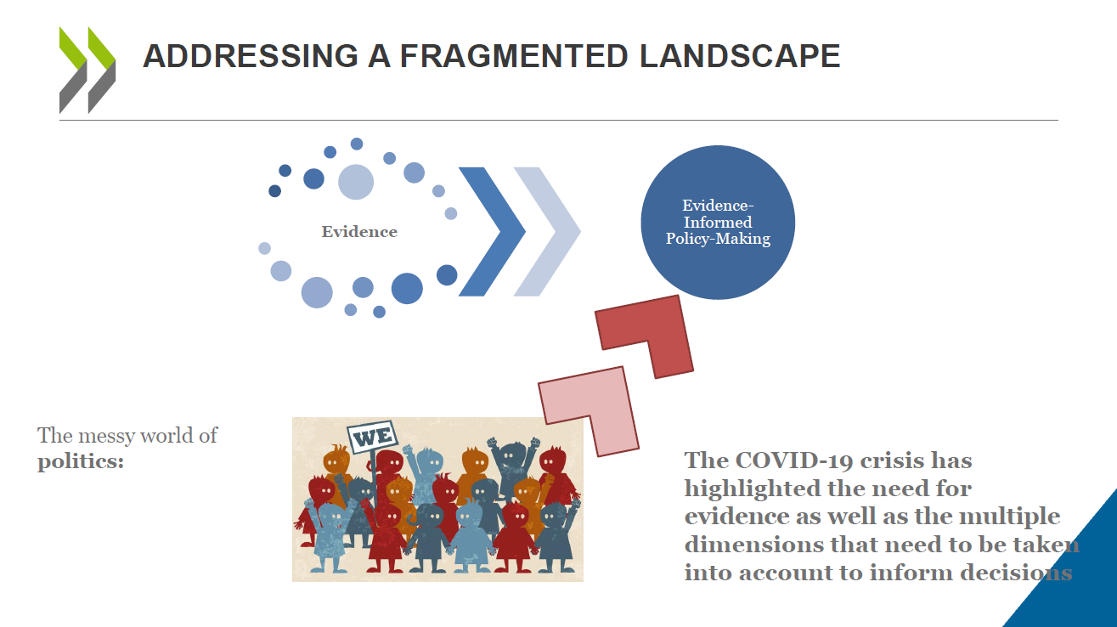

Slide 17
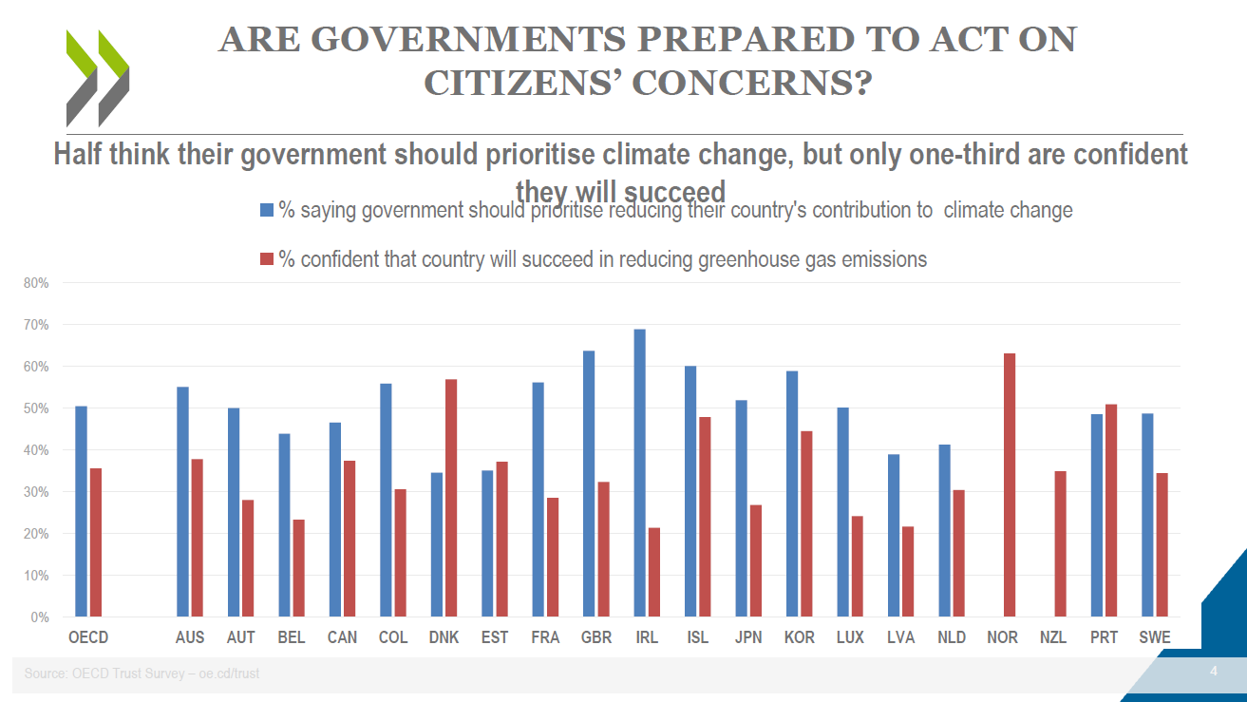

Slide 18
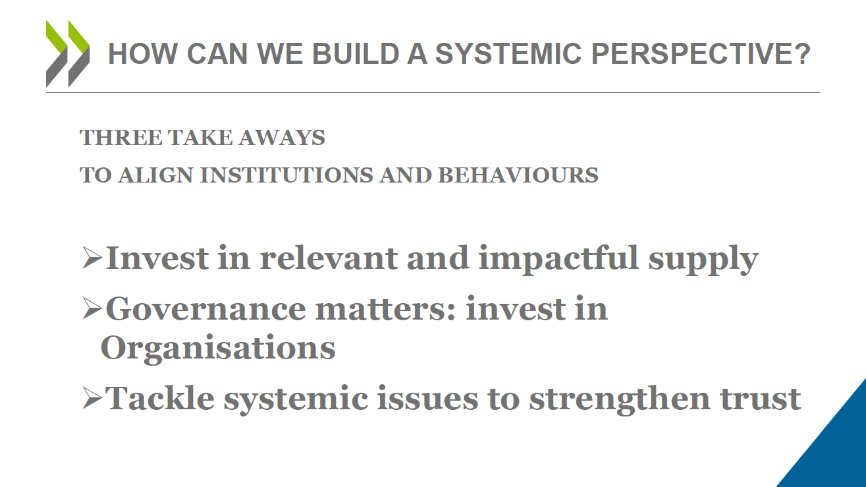

Slide 19
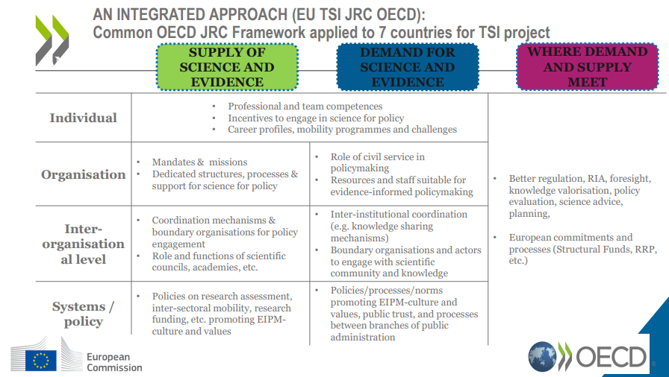

Slide 20
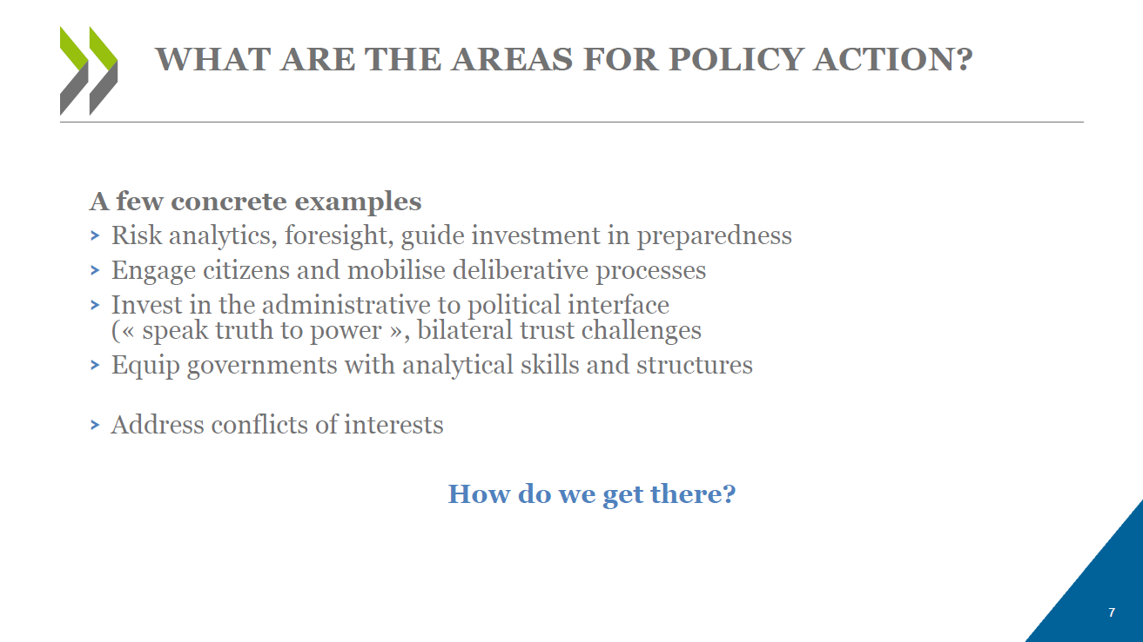

Slide 21
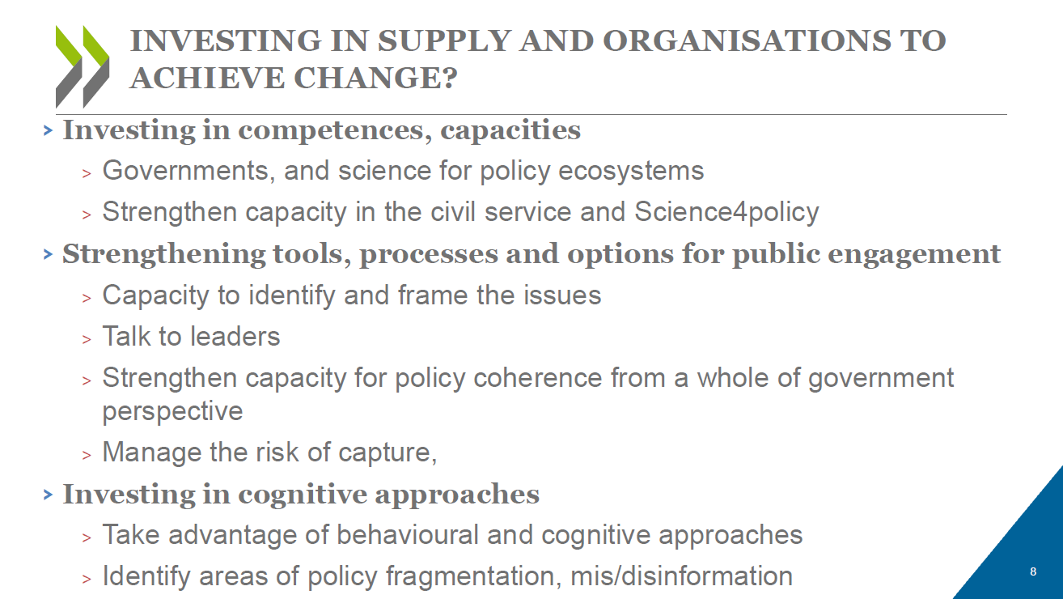

Slide 22
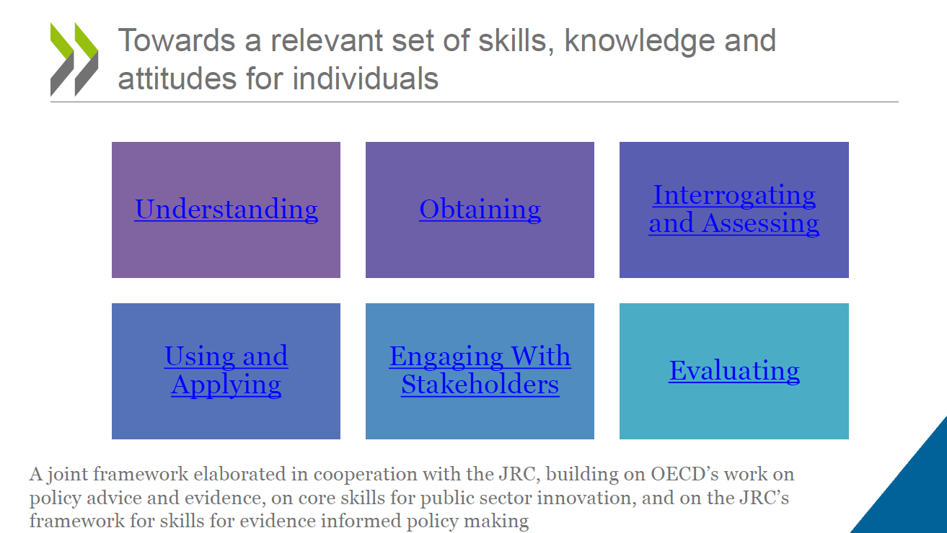

Slide 23
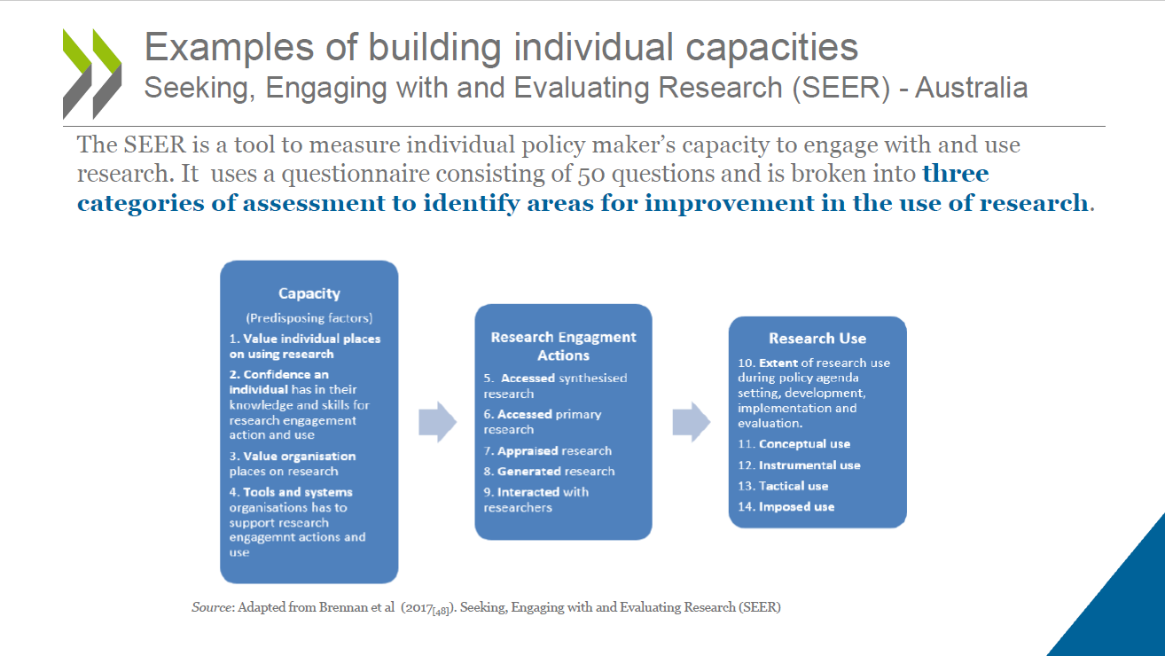

Slide 24
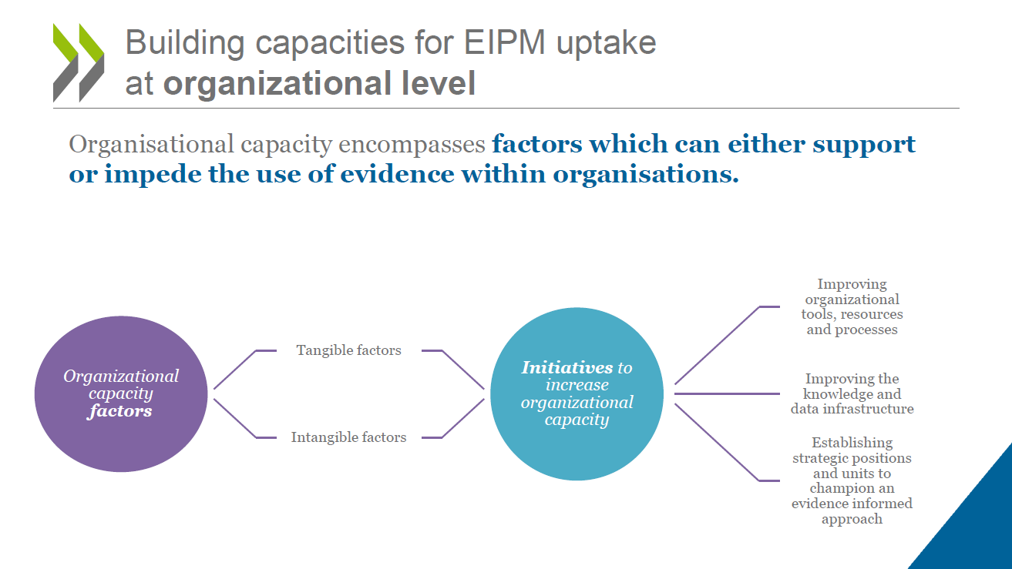

Slide 25
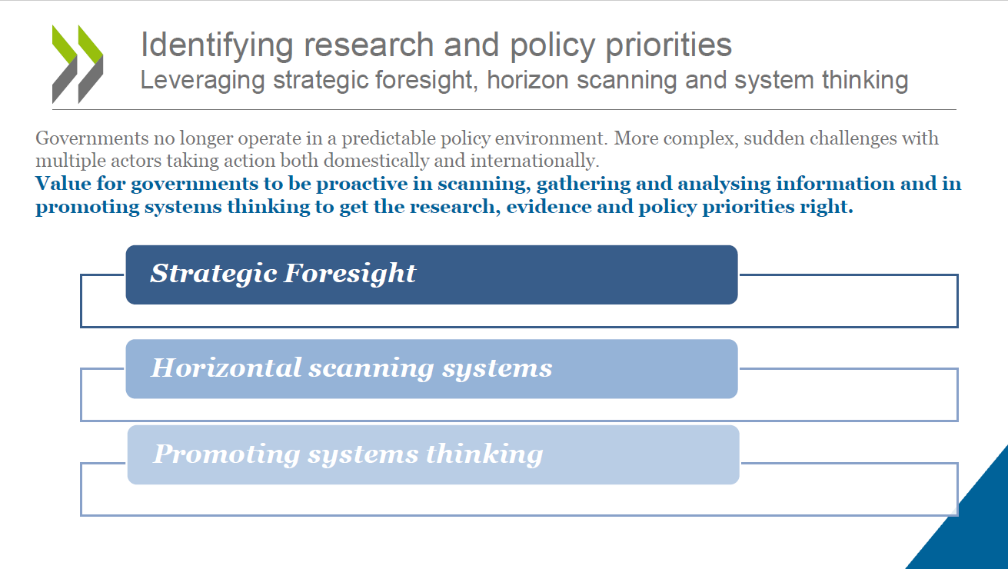

Slide 26
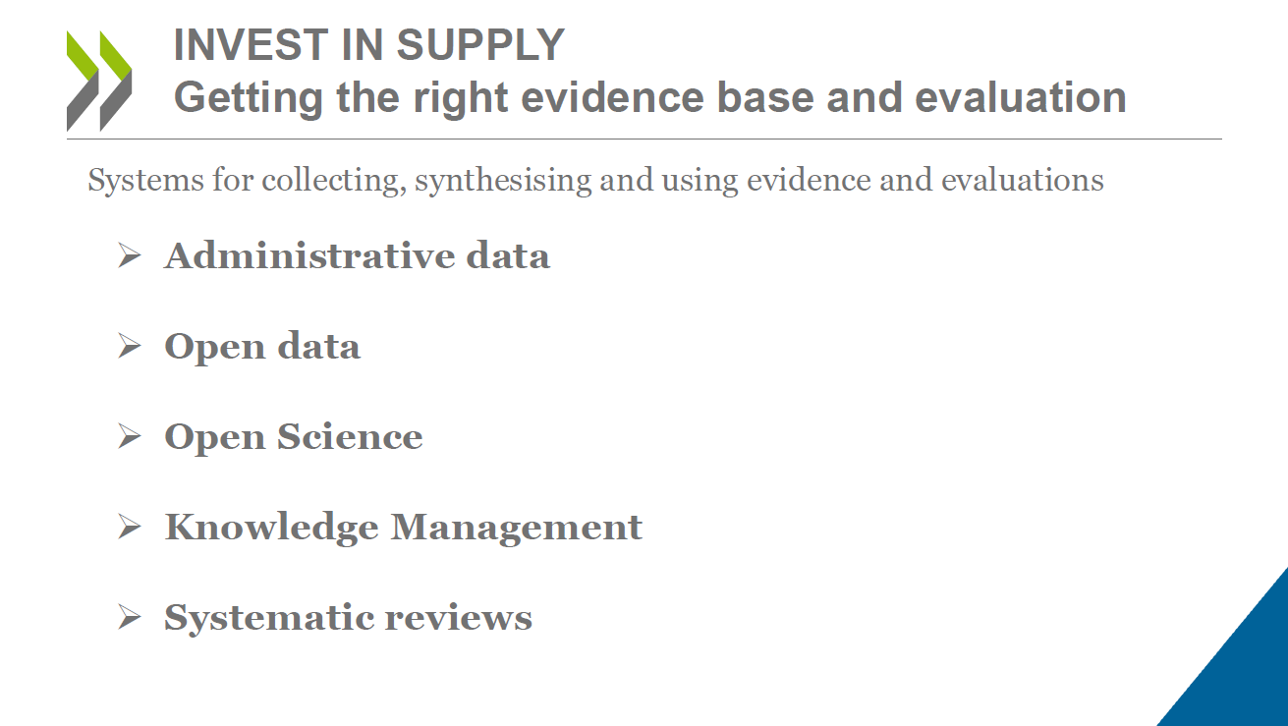

Slide 27
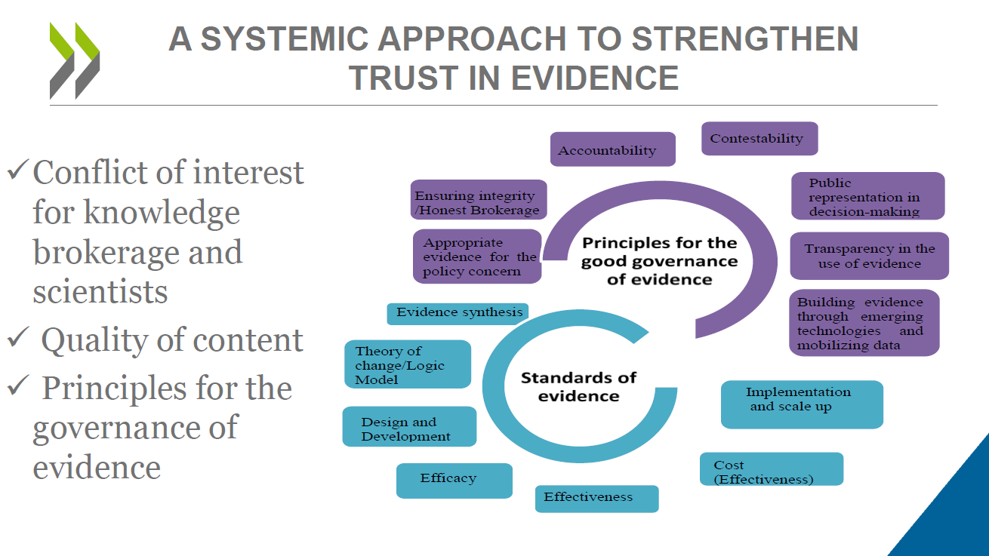

Slide 28
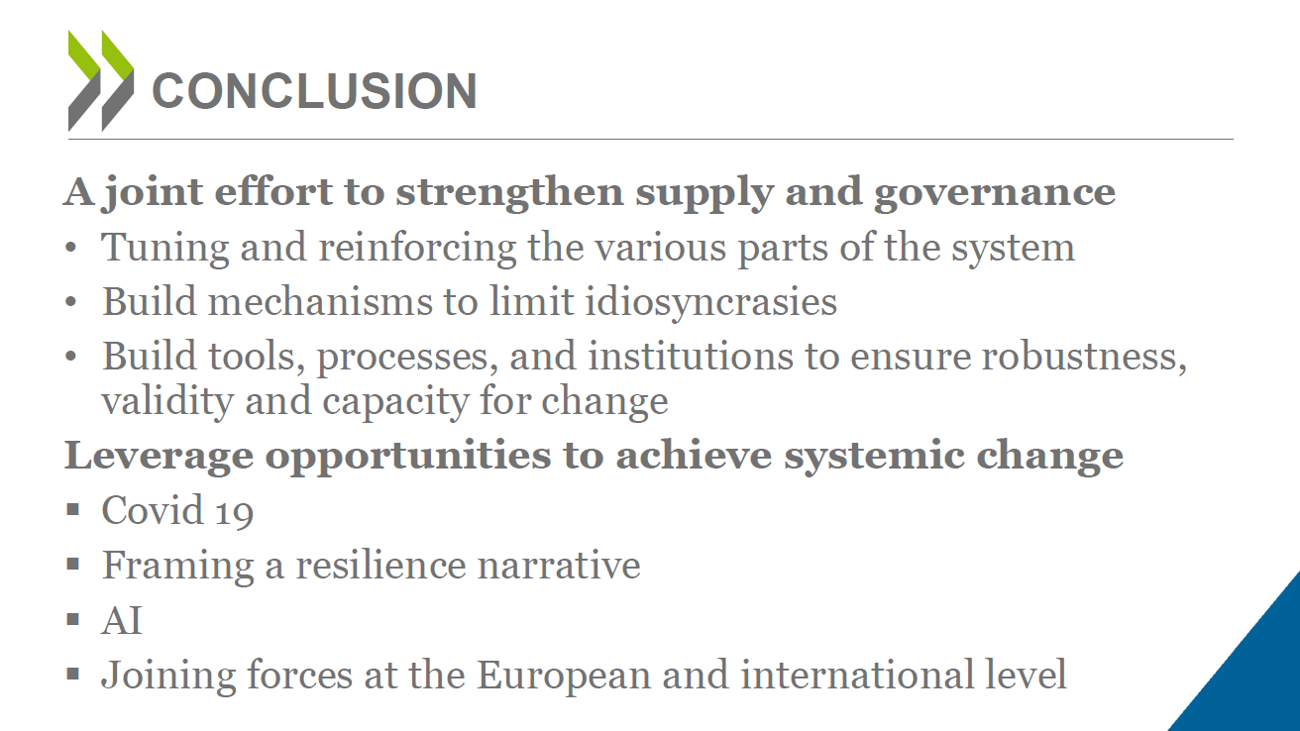

Slide 29


Slide 30
Professor of Science Communication and Impact Studies, Department of Communication and Psychology, Aalborg University
David Budtz Pedersen
The EIPM ecosystem as a whole and the framework for assessing its functioning
Notes:
Approved for publishing

Slide 31


@HumanomicsMap
Mapping and Strengthening
Science for Policy Ecosystems
David Budtz Pedersen PhD
Professor of Science Communication
Aalborg University Copenhagen
6 May 2024
Stronger Together I Brussels

Slide 32





David Budtz Pedersen
Professor of Science Communication
Aalborg University
Head of Humanomics Research Centre
Science Policy Adviser, Danish Government
Member of International Network for Government Science Advice
Member of the Norwegian Research Council for Breakthrough Science

Slide 33
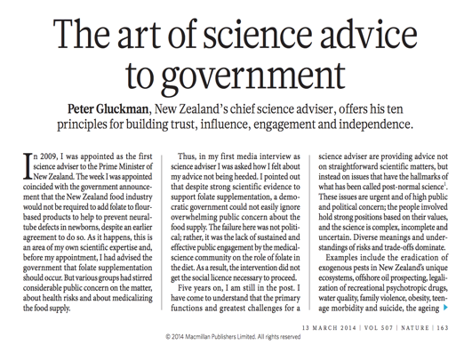
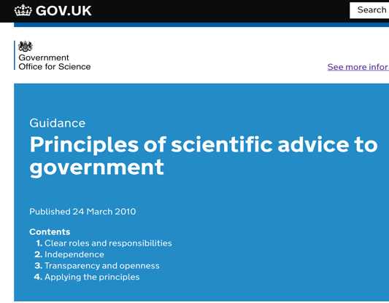

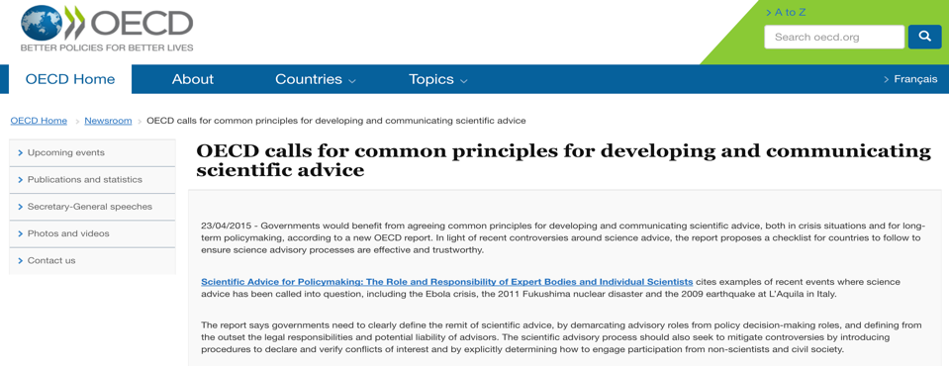

Slide 34


Slide 35
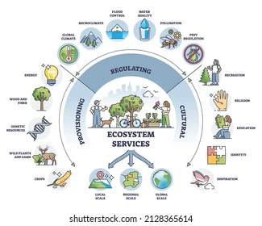
Changing landscape of science advice
Single-mechanism advisory systems are not well-suited for addressing complex cross-cutting policy issues.
Pandemics, artificial intelligence, climate change, security do not belong within single agencies, roles, or functions.
Traditional science advice systems often are atomized
by silos, disciplines, policy domains (lack of integration)
Addressing complex policy crises is a matter of concerted and coordinated action across advisory bodies.

Slide 36





Institutional capacity-building: science-for-policy ecosystems
14 workshops
Survey with 650 responses
Discussion papers
Community of 1,500+ professionals
Boundary organisations and knowledge brokers
Preparedness to provide science advice
Policymaking is done across all levels
Need to nurture a European and national debate

Slide 37
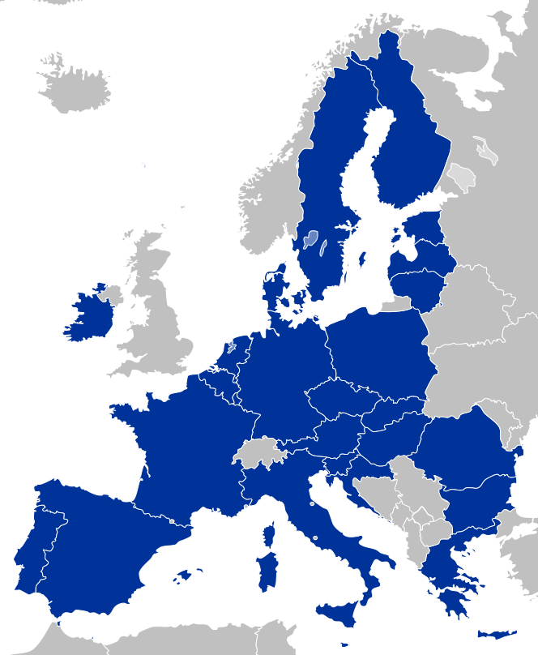
Findings: A lot is happening…
FI: Permanent science advice structure by academy
Increased interest in building S4P capacity in MS
EU support MS in building S4P capacity (ecosystems series, TSI)
Changes in EU policy frameworks
Better networking between actors, such as EU agencies, and more lesson learning from COVID-19
EE: Network of science advisors in ministries
CZ: Resilience and Recovery Plan includes building analytical capacity in government
IE: Public consultation on science advisory structures
PT: Establishment of PlanApp
ES: Establishment of Oficina C
Notes:
And it seems that policymakers share these sentiments.
There are many initiatives across Europe to promote S4P. This is just the tip of the iceberg.
And at EU level, with
-Better Regulation
-Public Admin Reform
-Knowledge valorisation
-F2P

Slide 38




…but not well-coordinated and connected
Science for policy (or science advisory) ecosystems
Scientific councils
Science advisers
Professional norms
Expert committees
Sectoral policies
Training
Foresight units
Better Regulation
Recruitment
Research policies
Consultation
Regulatory agencies
Public Administration Reform
Evaluation
Parliamentary offices of science & technology
Mandates
Impact Assessment
Universities
National academies
Research centres
Learned societies
Notes:
But what we see is that there these activities are not informed by a systemic view or a clear strategy.
This is why much of our work has started revolving around the concept of ecosystems – to capture the interplay of organisations and structures, with rules and policies, and practices and networks.

Slide 39



From mapping to strengthening ecosystems
Single elements
National ecosystems
European ecosystem
Analytical blind spots
Interconnectedness?
Missing the big picture
Knowledge coverage
Need for mutual learning
Ensure input to Better Regulation at the EU
Notes:
This is for us, as science and knowledge service to the European Commission, water down our mill. In fact, we have been in the business of capacity building for science for policy even before COVID-19, also in relation to capacity at national and sub-national levels.
Much of this work, and I know that many of you have kindly contributed or participated in this project already, revolves around our Science for Policy workshop series.
What we have been doing since September 2020 is to organise 10 interactive, co-creation workshops to map science for policy ecosystems across Europe, finding out what works and not and run a survey among the 600 professionals in our community and beyond on qualities of science for policy institutions and processes.
The analytical work will hopefully help us provide evidence-based advice to partners in MS that hope to strengthen and connect science for policy ecosystems.
Now I just wanted to share two central lessons from our analytical work with you.

Slide 40
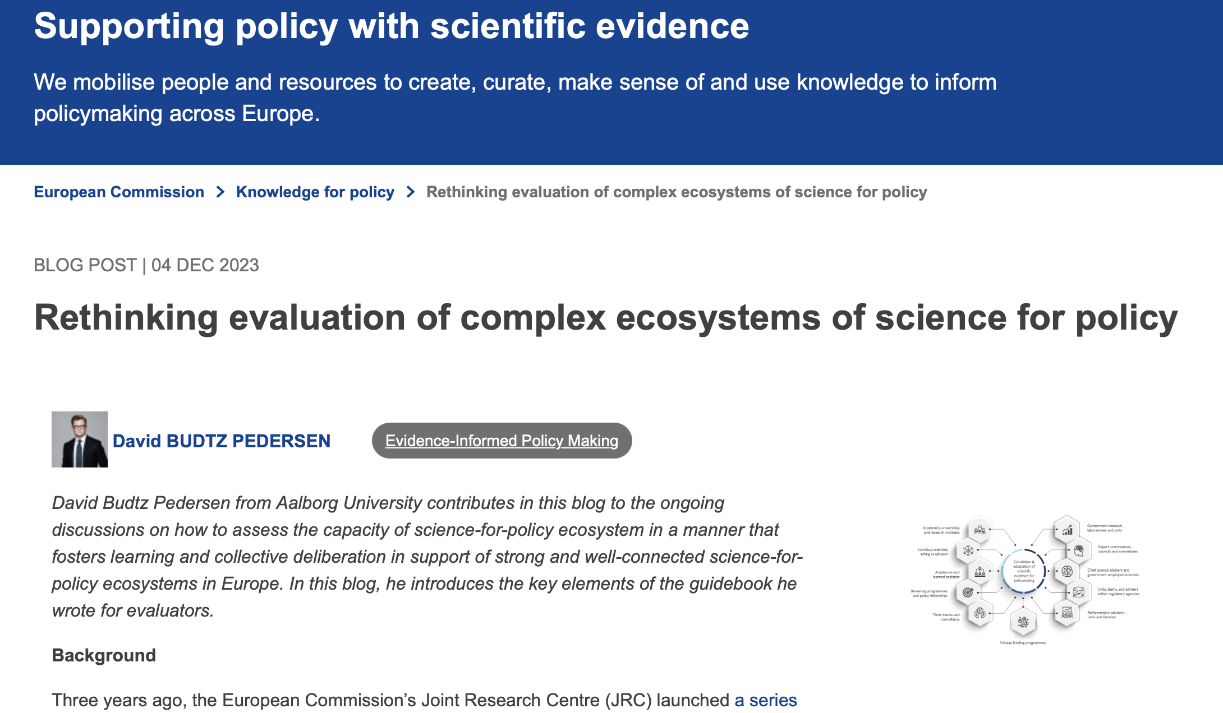

Slide 41
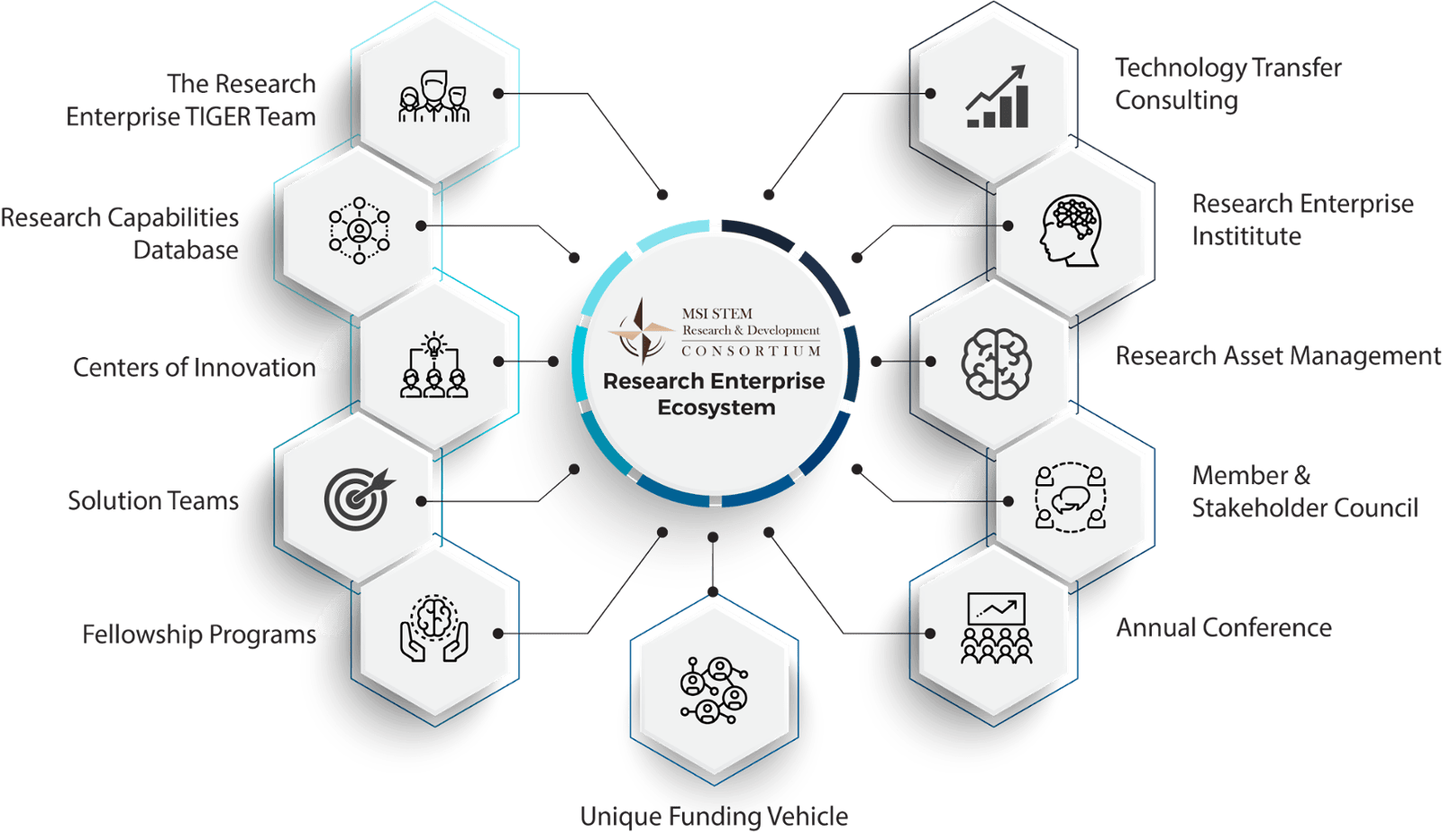
Government research laboratories and units
Academics, universities, and research institutes
Individual scientists
acting as advisors
Expert commissions and committees
Evaluation framework for science-for-policy in EU MS
Chief science advisors and government employed scientists
Academies and councils
Brokering programmes and policy fellowships
Units, teams, and advisors within regulatory agencies
Think thanks and consultancy
Parliamentary advisory units and libraries
Unique funding programmes
Forthcoming, JRC 2023

Slide 42
Science-policy-interface more fluid
than standard linear models suggest
Agenda setting
Policy
formulation
Research problem
Research
aims
Engage
Seek
Knowledge
exchange
Share
Review
and update
Policy
demand
Adoption
Reporting and
recommendations
Research
supply
Questions / methods
Inform
Discuss
Monitoring
and
evaluation
Implementation
Data
analysis
Data collection
Ojha et al. 2020

Slide 43

Mapping ecosystems of science advice
In 2021, in collaboration with EU Joint Research Centre and Danish Government, we conducted a mapping.
Part of an effort to assess the health and maturity of the Danish ecosystem
Research institutes, commissions, scientific councils, expert committees, national academies.
  Technical science advice (climate, environment, chemicals, food)
  Fiscal science advice (economic councils, internal units, etc.)
  Legal science advice (20+ legal councils, e.g., health etc.)
  Cultural science advice (national security, police, intelligence)
  Ethical advice (the ethical council, data ethics, health ethics)

Slide 44
Different roles in a science advisory ecosystem
Budtz Pedersen, D. & Hvidtfeldt, R. (2021). The Danish Eco-System of Science for Policy. Ministry of Higher Education and Science. Copenhagen.

Slide 46
Findings and shortcomings
Ecosystem-wide competences to ”procure” advice and ”provide” advice are incomplete and fragmented.
No central coordination or systemic integration
Lack of interdisciplinarity and diversity
Lack of behavioural science advice
Lack of ”everyday” coordination practices to support ”emergency” response capacity (siloed, fragmented).

Slide 47
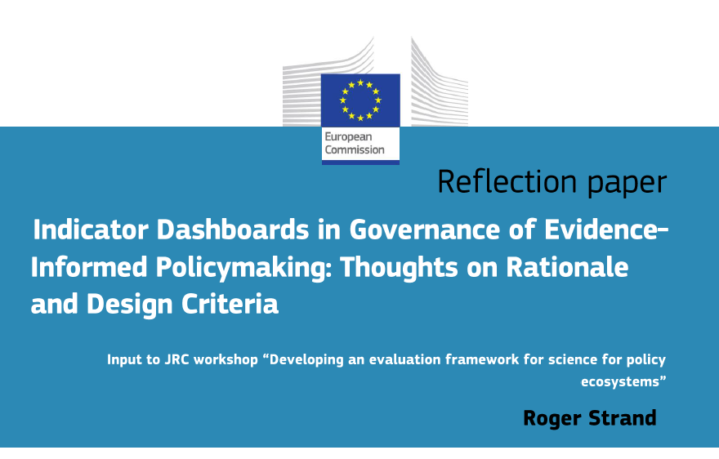

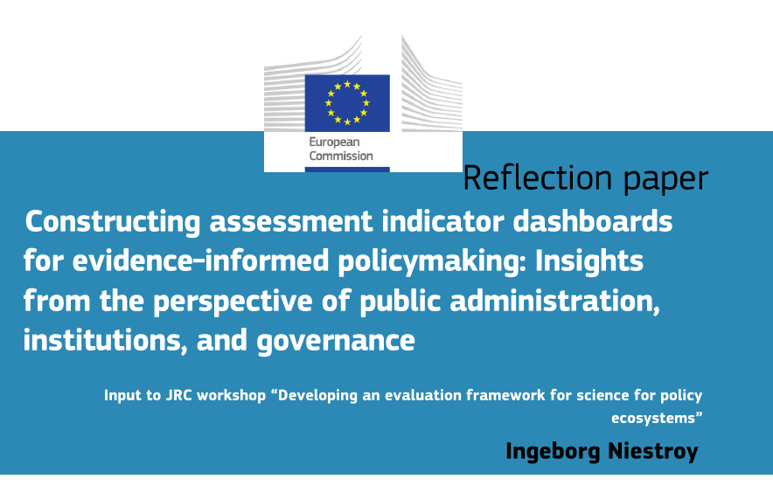
Indicator dashboards
From quantification to qualitative assessments
  For key functional requirements and normative principles underlying S4P institutions
  Advice on inclusive evaluation process

Slide 48
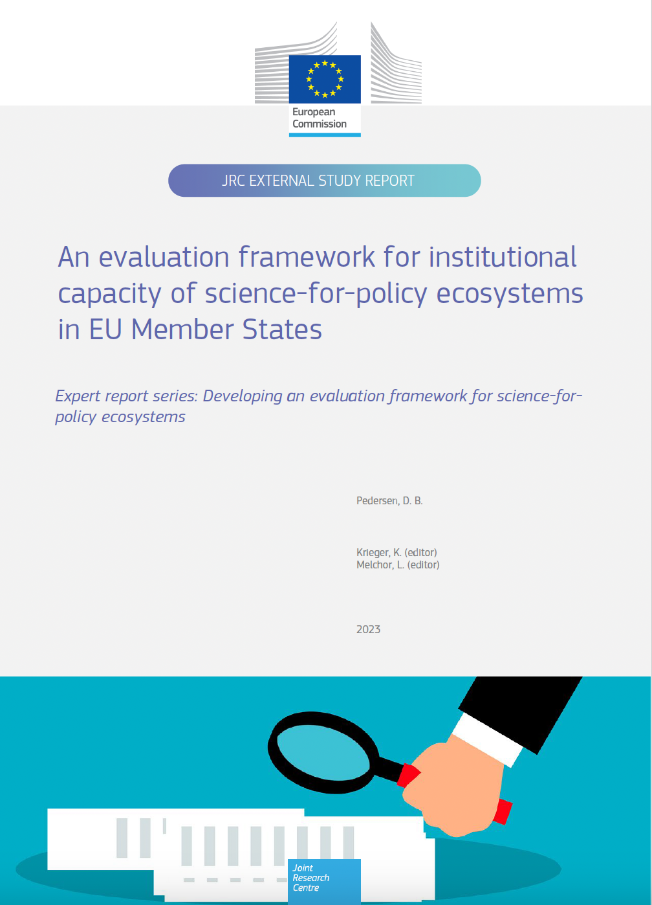
Evaluating the ecosystem
An institutional ”health check”
Ecosystems are relational, structured by interactions and connections.
More fluid and more diverse than standard system-thinking models allow.
Knowledge is co-produced , circulated, and co-opted by different agents in different settings.

Slide 49
Foundational principles for science-to-policy
Budtz Pedersen, D. (2023). Science Advice Principles. Preprint available

Slide 50
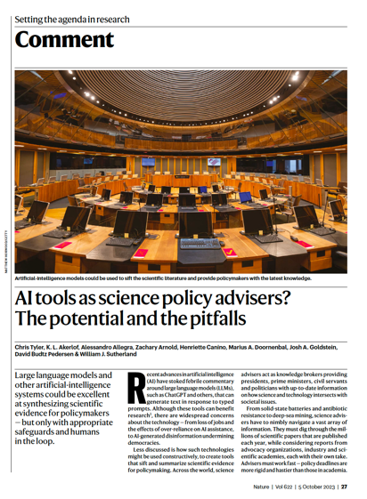


Thank you for the attention
David Budtz Pedersen: davidp@hum.aau.dk
Twitter: @HumanomicsMap
Website: http://mapping-humanities.dk
Supported by

Slide 51
Go to: Menti.com
Code: 4733 8379

Slide 52
Q&A and debate
12:10-12:40
12:10-12:40

Slide 53
Lunch break
12:40-14:00

Slide 54
#StrongerTogether:
SSAH and the future of evidence-informed policymaking
DAY 2
#StrongerTogether: SSAH

Slide 55
Plenary session
09:15-09:45

Slide 56
Plenary session
12:10-12:40
11:30-11:45

Slide 57
Professor of Economics, University of Alberta and College of Europe
Rick Szostak
Key note speeches on SSAH, multidisciplinarity and policymaking
Notes:
Approved for publishing

Slide 58
Perspectives on Interdisciplinary SSAH Policy-Making
Rick Szostak
University of Alberta
College of Europe
Stronger Together Conference, Tervuren, BE, May 7, 2024

Slide 59
Integrating across SSAH
Will better transcend scholarly biases (every discipline has favoured theories, methods, and phenomena to study)
Will better identify side effects
Will better capture the complexity of policy challenges
Will better prepare us for instability and unknown unknowns
Will first evaluate disciplinary insights in a way that complements disciplinary evaluation, and then integrate the best ideas

Slide 60
A Further Kind of Integration
We should then enhance ties between integrative scholars and policy-makers.
These should interact regularly so that academics know the challenges being faced, and can address these.
So we need a sizeable body of integrative scholars in regular contact with policy-makers
See https://i2s.anu.edu.au/

Slide 61
The skills of integrative scholars
May also be useful in mediating among competing interests (and identifying their core interests and beliefs)
May also be useful in communicating policy proposals to diverse audiences
Are also invaluable when policies are later evaluated

Slide 62
Interdisciplinarity and Instability
We may not often need to understand how pandemics or wars affect economies, but it is sometimes really important.
More generally all disciplines tend to focus on the forces generating stability within subsystems: economic stability, cultural stability etc.
They all recognize instability but tend to treat sources of instability as exogenous.
Economics largely focuses on equilibria or constrained cycles. Even when we discuss growth we often theorize a very stable kind of growth.
Interdisciplinary analyses often try to grapple with change and instability.
We need to understand both stability and instability.
“Stability, Instability, and Interdisciplinarity” Issues in Interdisciplinary Studies.35, 65-87, 2017.

Slide 63
Historical Transformations
ALL historical transformations involves cross-disciplinary linkages. That is, economic transformations do not just have economic causes or effects.
Recognizing this, we should not expect the Great Depression to have been an entirely economic event. [There are very good reasons to blame much of it on the time path of technological innovation]
Looking forward we will be much better able to cope with the future if we explore cross-disciplinary linkages.
“Can examining cross-disciplinary interactions illuminate unknown unknowns? Integration and Implementation Sciences, January 2021 (blog post) https://i2insights.org/2021/01/05/cross-disciplinarity-illuminates-unknown-unknowns/comment-page-1/#comment-30503 This was re-blogged in July 2023.

Slide 64
Integration (Requires creativity)
Strategies to achieve integration:
  Redefinition: Meanings of concepts are clarified.
  Theory extension: A theory is broadened in scope to envelop the concerns of other theories.
  Organization: Seemingly unrelated concepts are placed in some relationship or classification.
  Transformation: Opposing insights are placed on a continuum.

Slide 65
Interdisciplinary Evaluation
It is important to appreciate that interdisciplinary evaluation complements disciplinary evaluation.
Disciplinary referees and editors will ask whether disciplinary theory and method are properly applied.
Interdisciplinary analysis asks what alternative theories and methods might have found, whether disciplinary perspective guides results, and why results might differ across disciplines. [Students can find this empowering.]

Slide 66
Disciplines
Establish a mutually supportive set of theories, methods, phenomena to study, and epistemological beliefs. This evolves slowly through time, and is reflected in a set of guidelines for hiring, promotion, publication.
The rise of behavioral and experimental economics shows how evolution can involve a new coherent set.

Slide 67
Synergy between Specialized and Integrative Research
Integrative research integrates across phenomena, theories, and methods, drawing upon specialized research
Can then inform specialized researchers of the benefits of alternative phenomena, theories, and methods
If we want a more coherent social science, we will need something more than just strong disciplines.

Slide 68
Challenges in Collaborating with other Human Scientists
Different and often vague terminology
Differences in epistemological outlook
Quantitative versus qualitative
Research impact (pros and cons)

Slide 69
An Integrated Human Science
The Map of Human Science (and a recognition that all subsystems are open)
Integrative research within and among disciplines (That is, we need to devote much more effort to tying the pieces together.)
Recognition that all theories and methods are imperfect; have compensating strengths
Clarity in terminology and expression
Constructive postmodernism
Integrating the Human Sciences: Enhancing Cohesion and Progress across the Social Sciences and Humanities. London: Routledge. 2023.

Slide 70


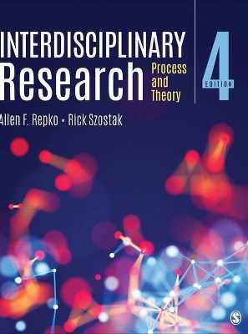
Some Recent Books (5th ed. in progress)

Slide 71
Go to: Menti.com
Code: 4733 8379

Slide 72
Lunch break
12:30-13:30

Slide 73
Ghent University
Jeroen Bourgonjon
Cocreating policies with scientists, citizens and local authorities: the case of Ghent
Notes:
Not approved for publishing yet

Slide 74
CONSENT PENDING…

Slide 75
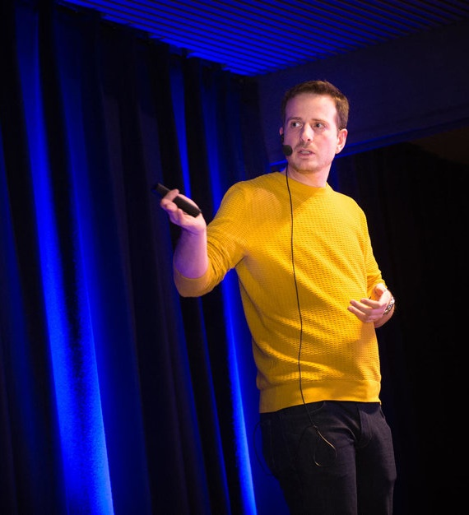

Delta
Interdisciplinary consortium
Impact coordinator
Not that kind of a business developer

Slide 76

Delta
Interdisciplinary consortium
Impact coordinator
Not that kind of a business developer
“
Digital innovation
For individuals and society

Slide 77


What is technologically possible is not always socially desirable
Activity calendar
Nobody can predict the future, yet we have to prepare for it.
We summarize societal trends in future scenarios that foster debate.
DELTA
THEME

Slide 78
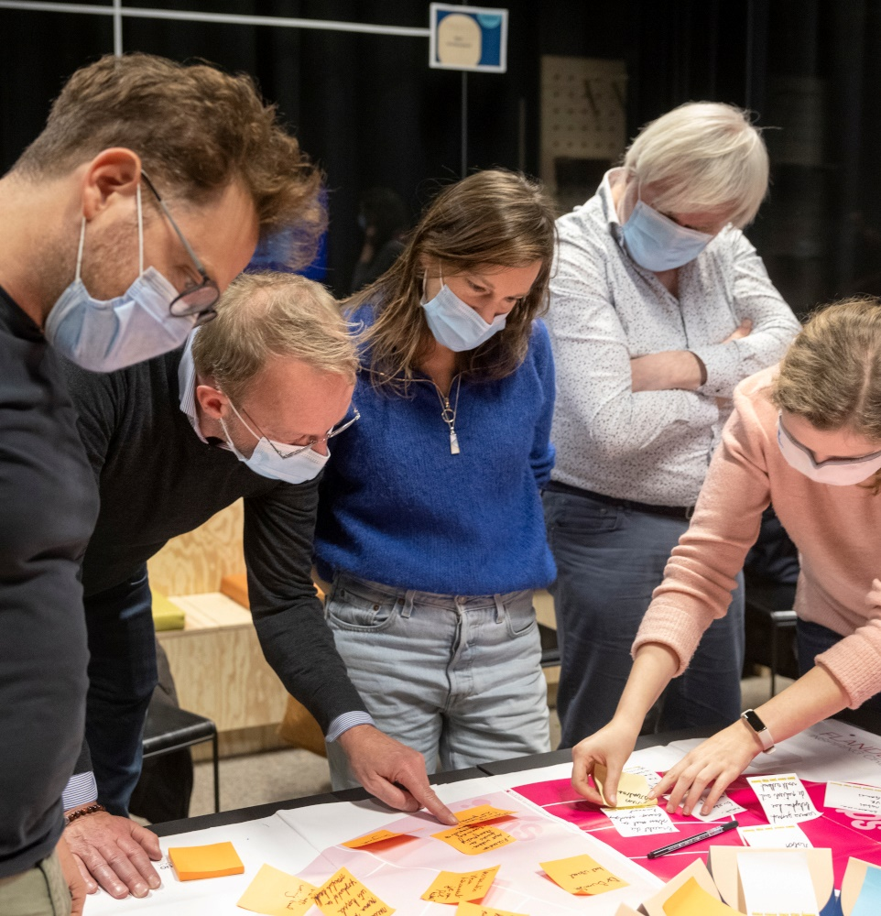

Vision
What do we stand for?
Ghent(ians)
Citizen participation

Slide 79
Impact
hub

Slide 80


Vision
What do we stand for?
Ghent(ians)
Citizen participation
Technology
We believe in the potential

Slide 81



Slide 82
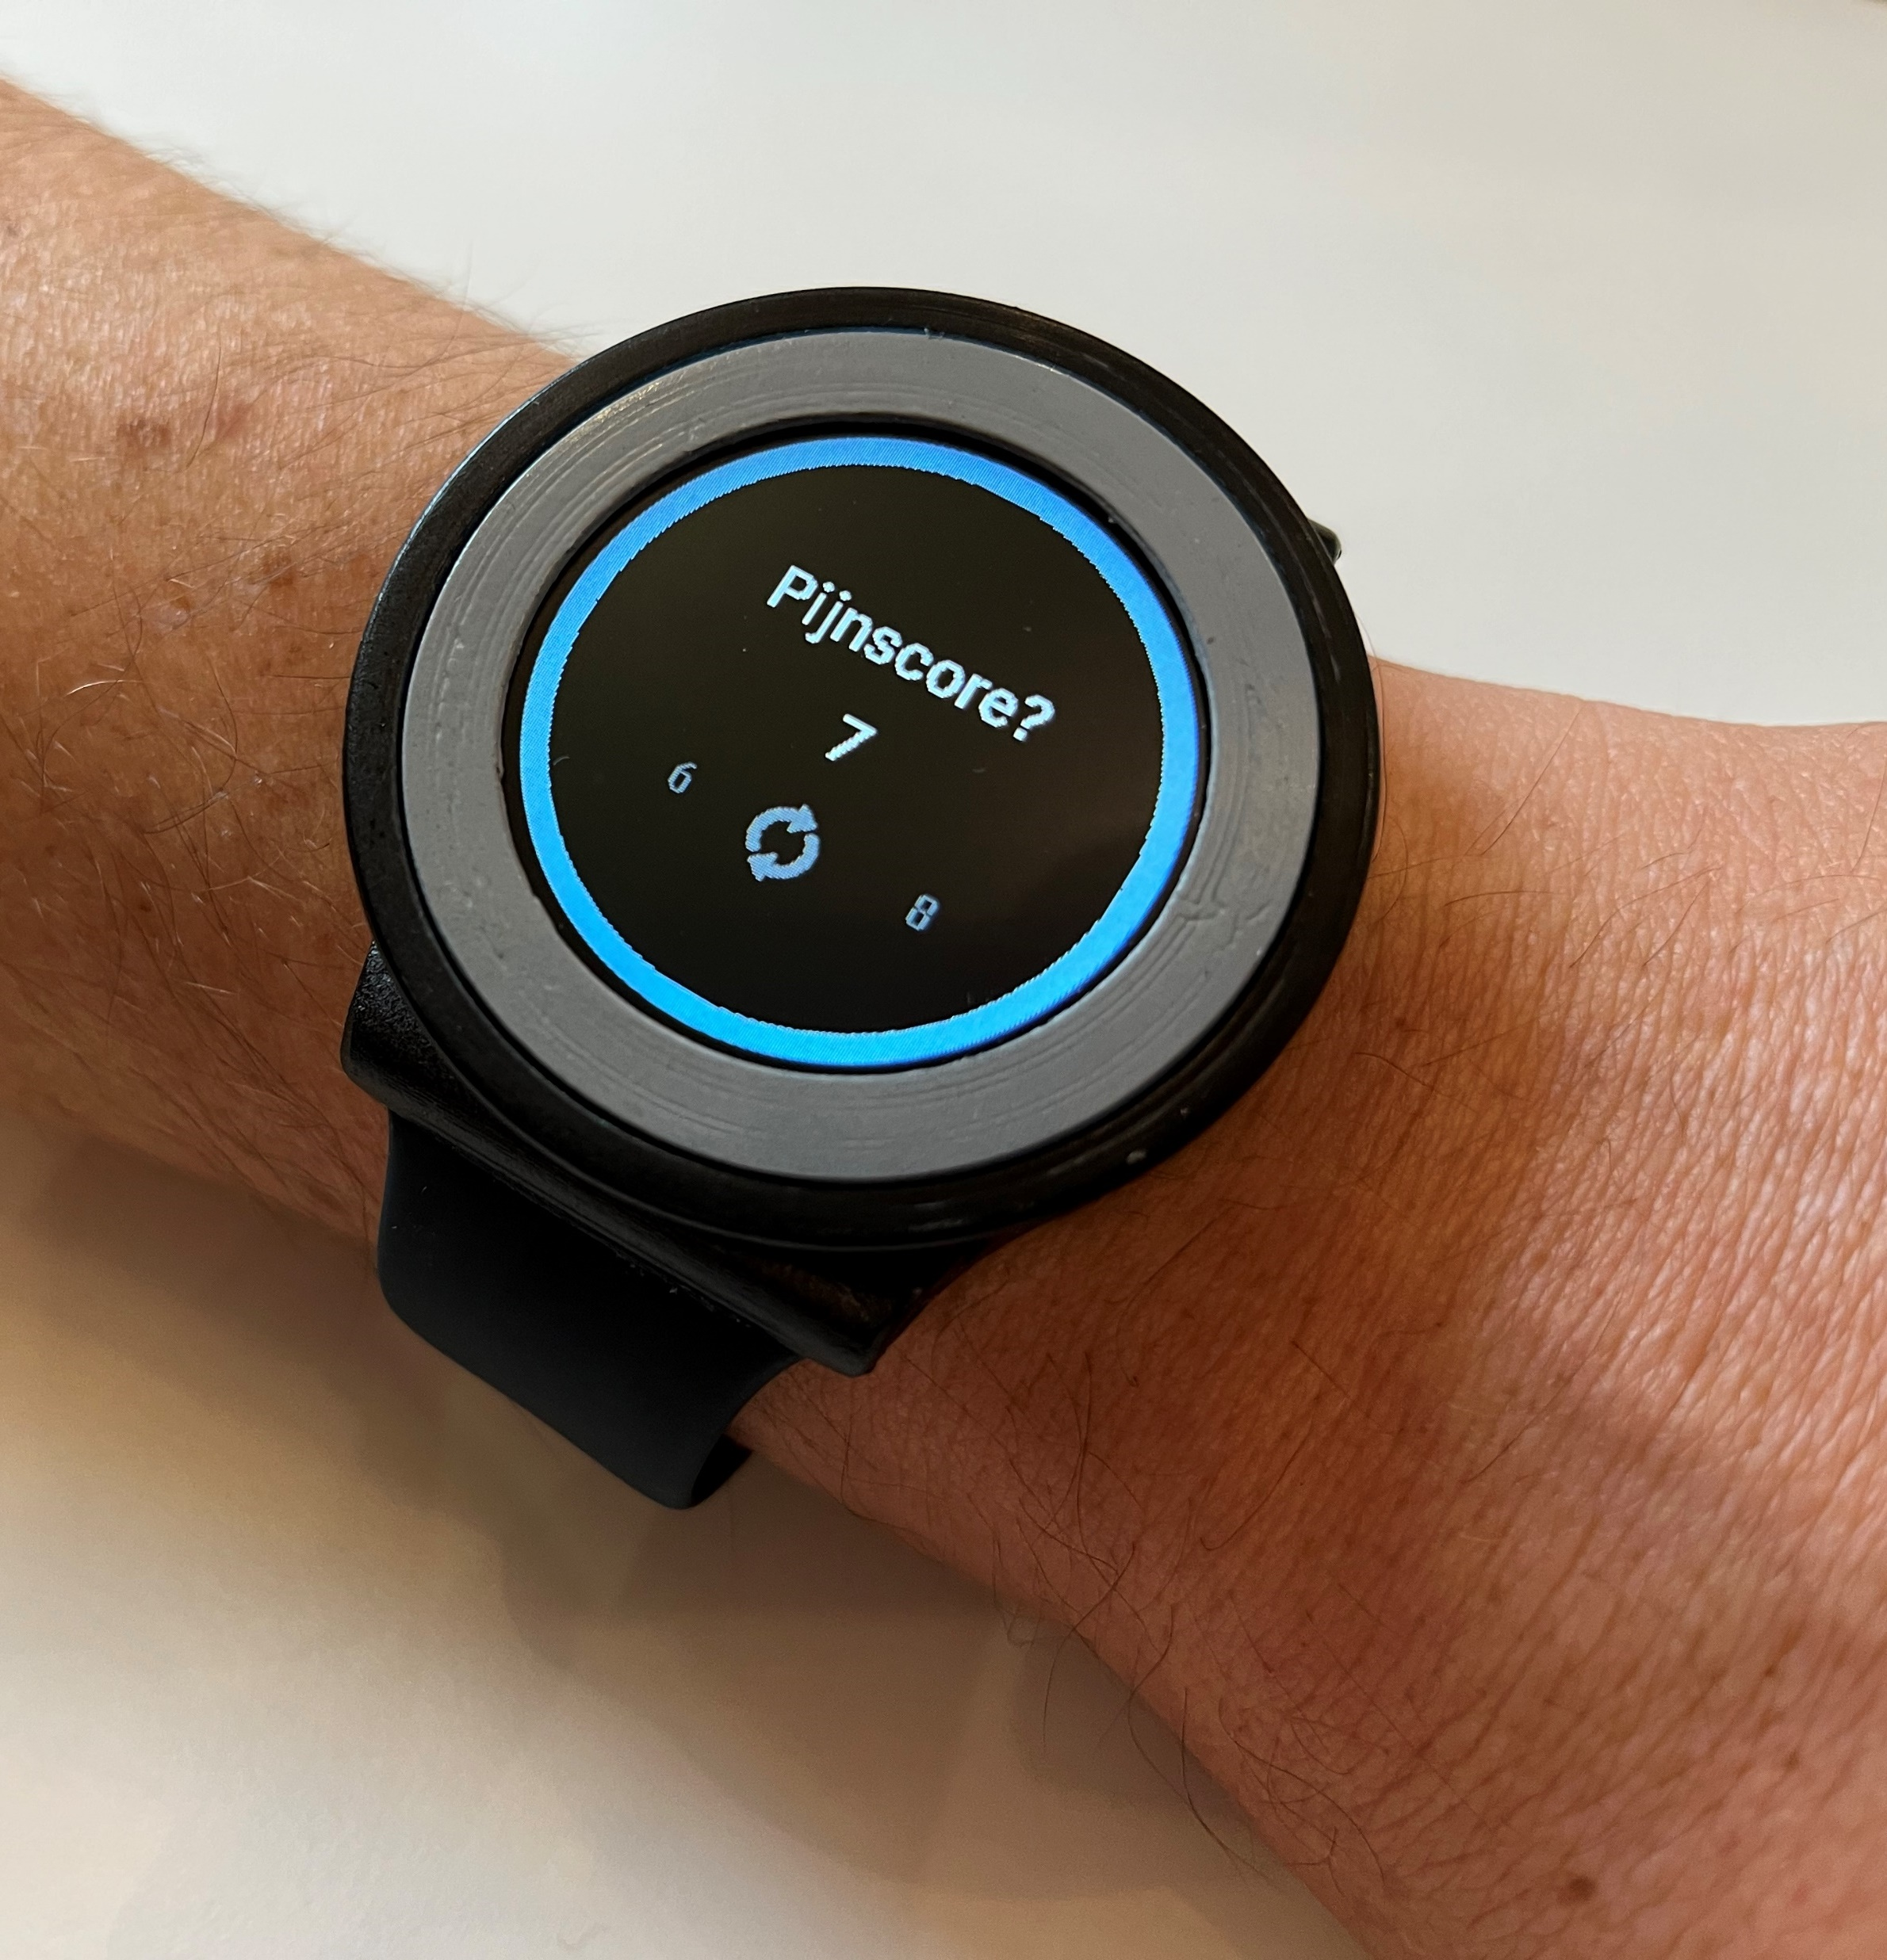
Vision
What do we stand for?
Ghent(ians)
Citizen participation
Technology
We believe in the potential
Prototyping
Thinking, but also doing

Slide 83

Theme
Thematic approach
One central theme
Chosen based on support

Slide 84
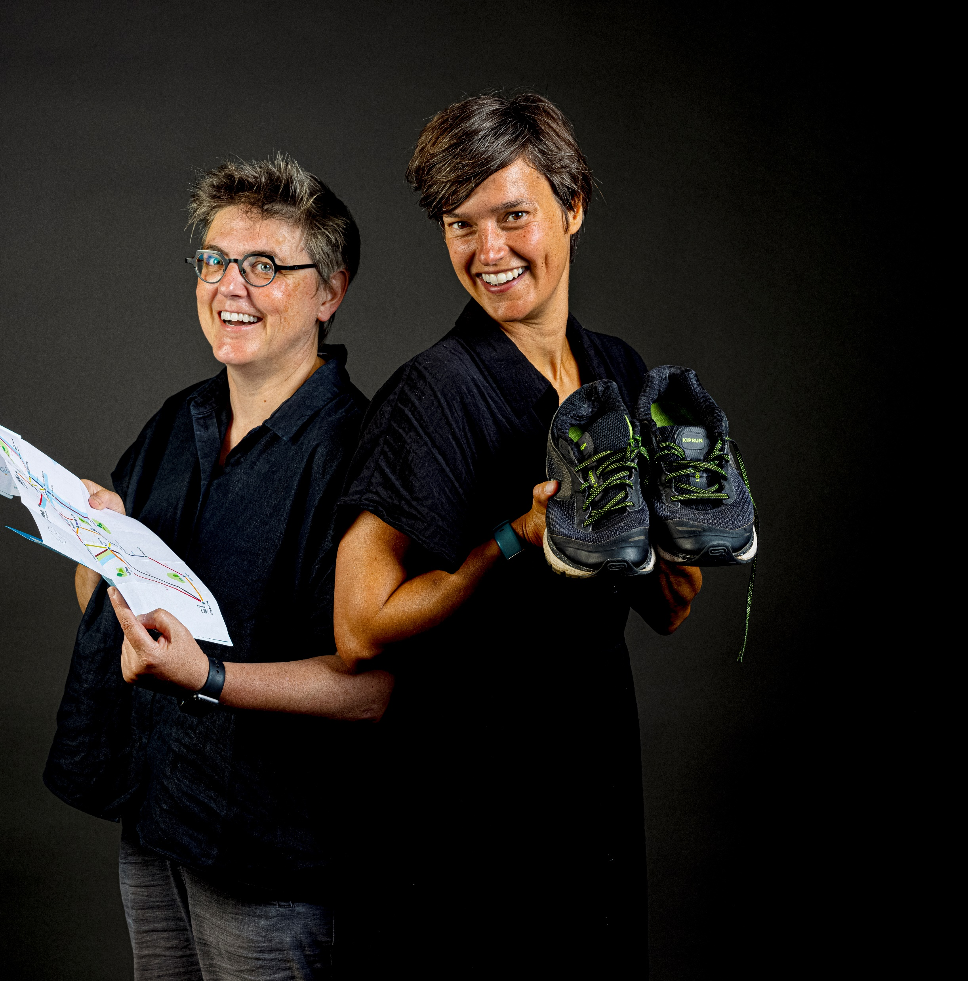
Theme
Thematic approach
One central theme
Chosen based on support

Slide 85

Theme
Thematic approach
One central theme
Chosen based on support
Timeline
One and a half year

Slide 86


What is technologically possible is not always socially desirable
Activity calendar
Nobody can predict the future, yet we have to prepare for it.
We summarize societal trends in future scenarios that foster debate.
DELTA
THEME

Slide 87


Theme
Thematic approach
One central theme
Chosen based on support
Timeline
One and a half year
Collaboration
Search for win-win

Slide 88
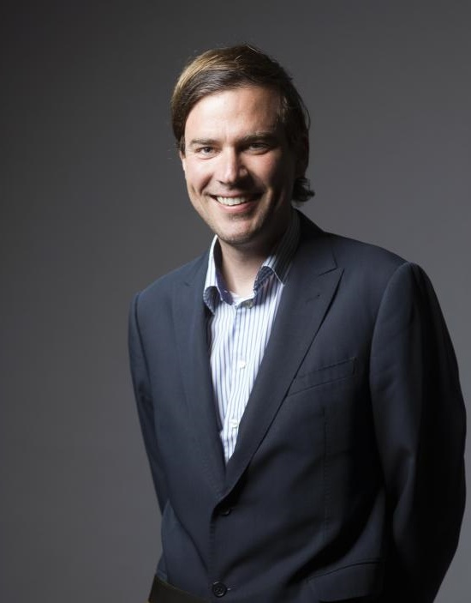
Engagement
Policy makers in Comon
Organizational
Representation at every level of governance

Slide 89
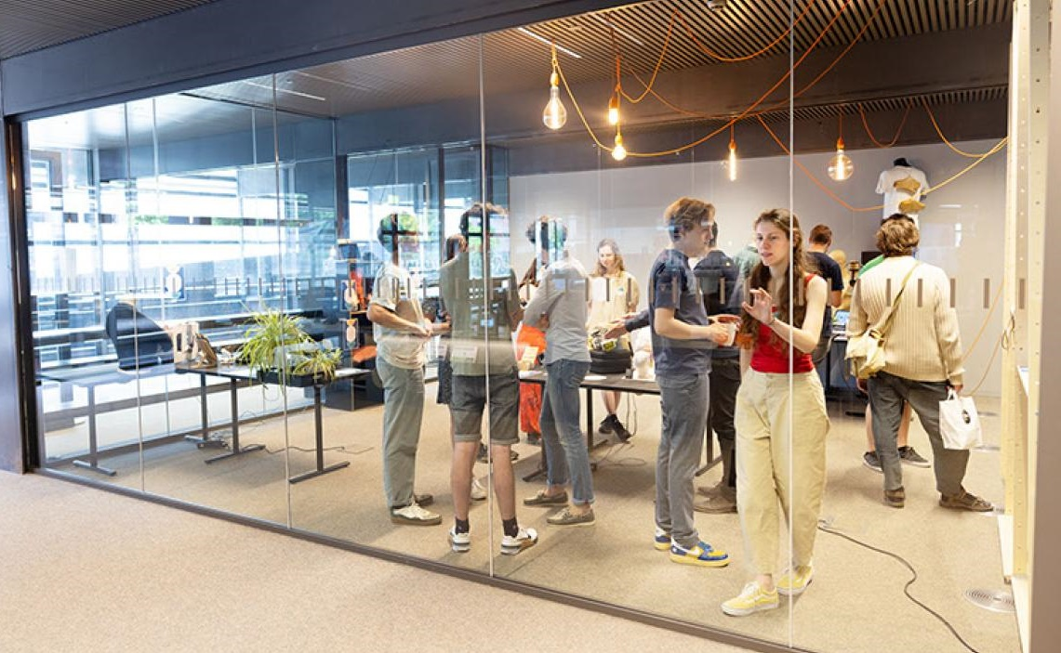

Approach
Design thinking
SOCIAL
DEBATE

Slide 90

Engagement
Policy makers in Comon
Organizational
Representation at every level of governance
Financially
Every organization invests 25.000 euro

Slide 91
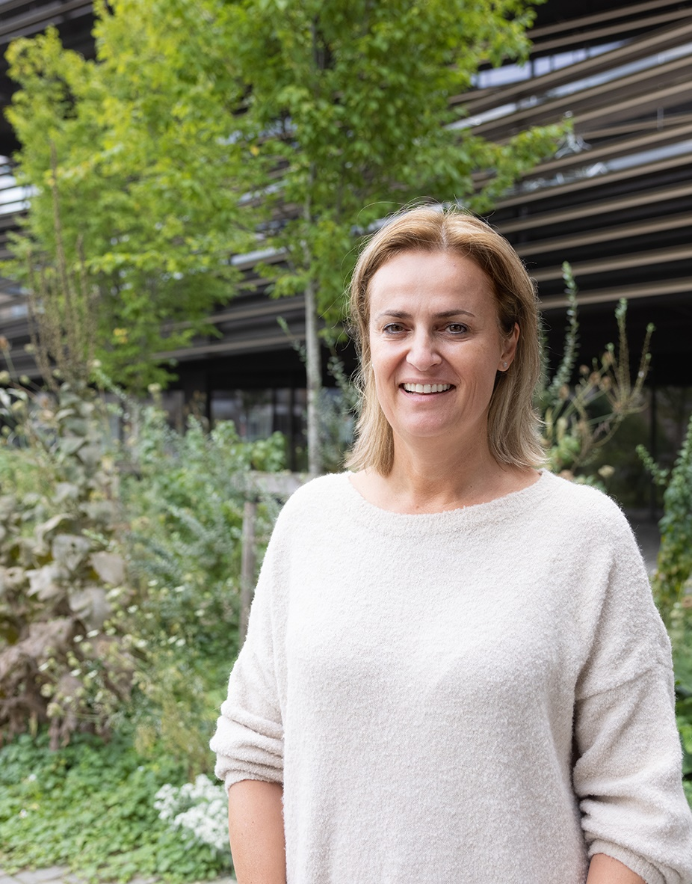
Engagement
Policy makers in Comon
Organizational
Representation at every level of governance
Financially
Every organization invests 25.000 euro
Participants
Policy makers involved in every step

Slide 92
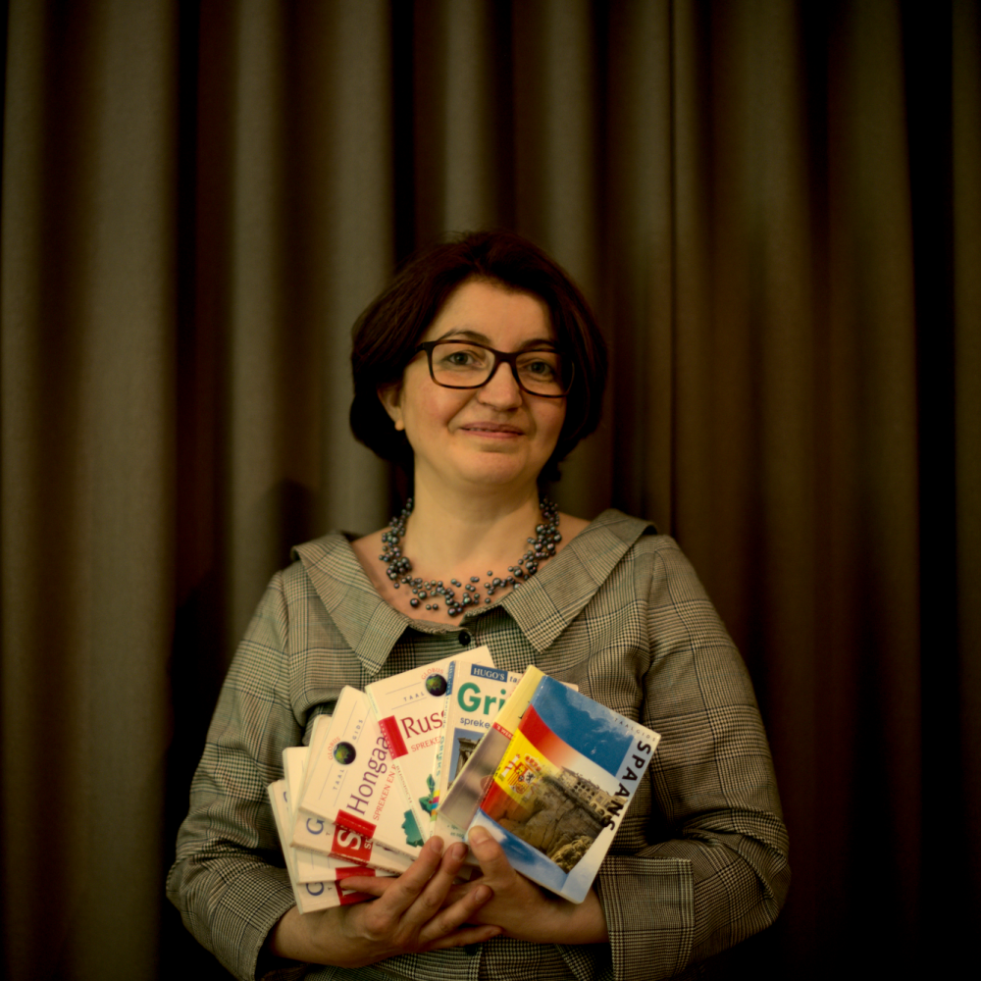
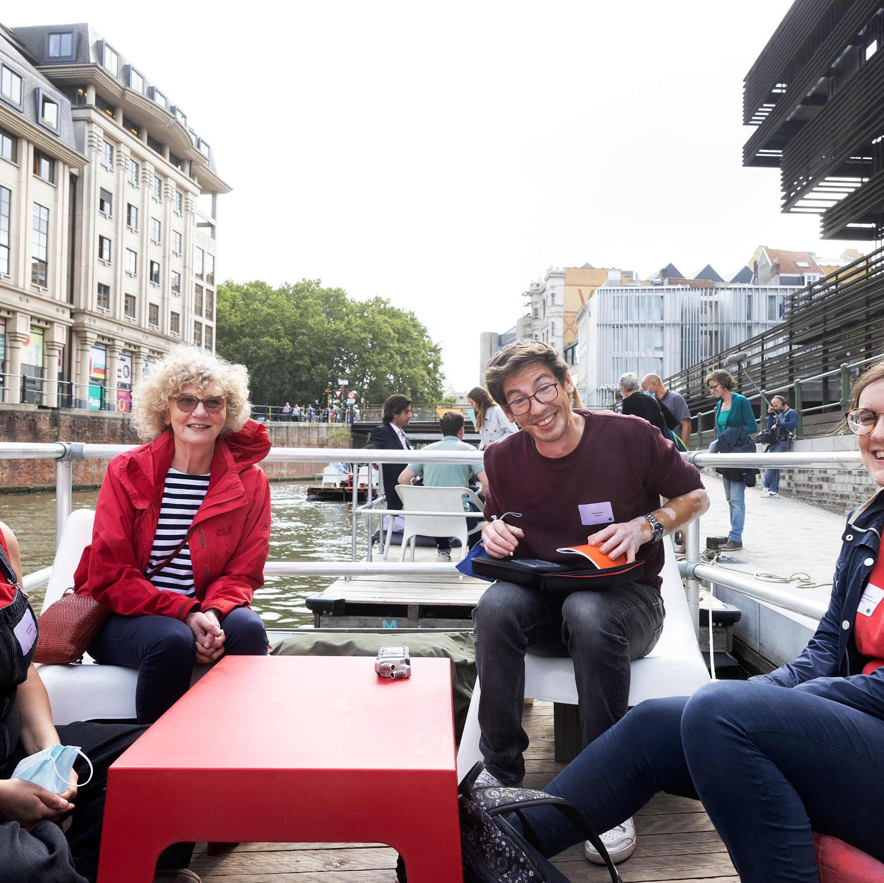
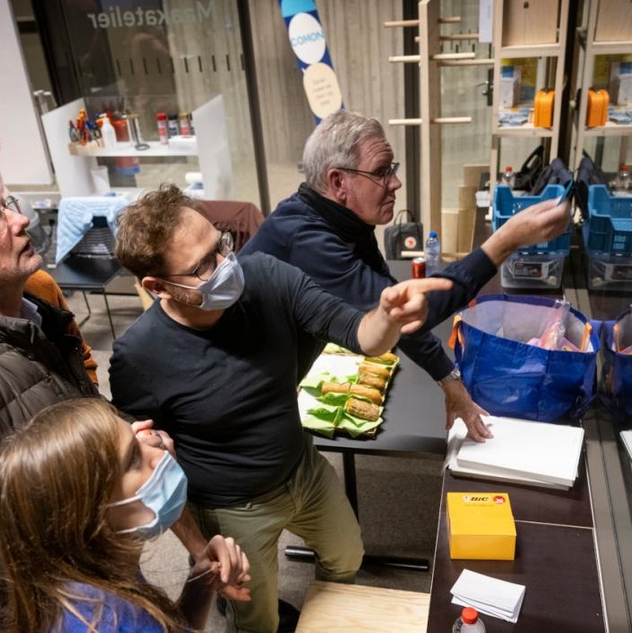

Approach
Fase 1
Fase 2
Fase 3
Fase 4
Challenge
Problem
Creation
Experiment
What challenge should we address?
Who should we engage? Who has the expertise?
How should we approach the problem?
How can we test our solutions?
Notes:
Uitdaging: “Stad zorgt ervoor dat we een breder bereik kennen via OCMW, stadsdiensten, stadsmagazine …”
Probleemstelling: “Aanwezigheid van beleidsmakers, naast ervaringsdeskundigen en academisch experten”
Creatie: “”
Experiment: “”

Slide 93


Positive
Advantages for policy makers
Together we can do more
R&D, citizen participation, sensitization
Notes:
Voorbeeld Living Labs werking – 200.000 euro extra funding voor onze Miniproeftuinen.
Voor de Stad Gent: lerend netwerk opgezet rond Living Labs.

Slide 94
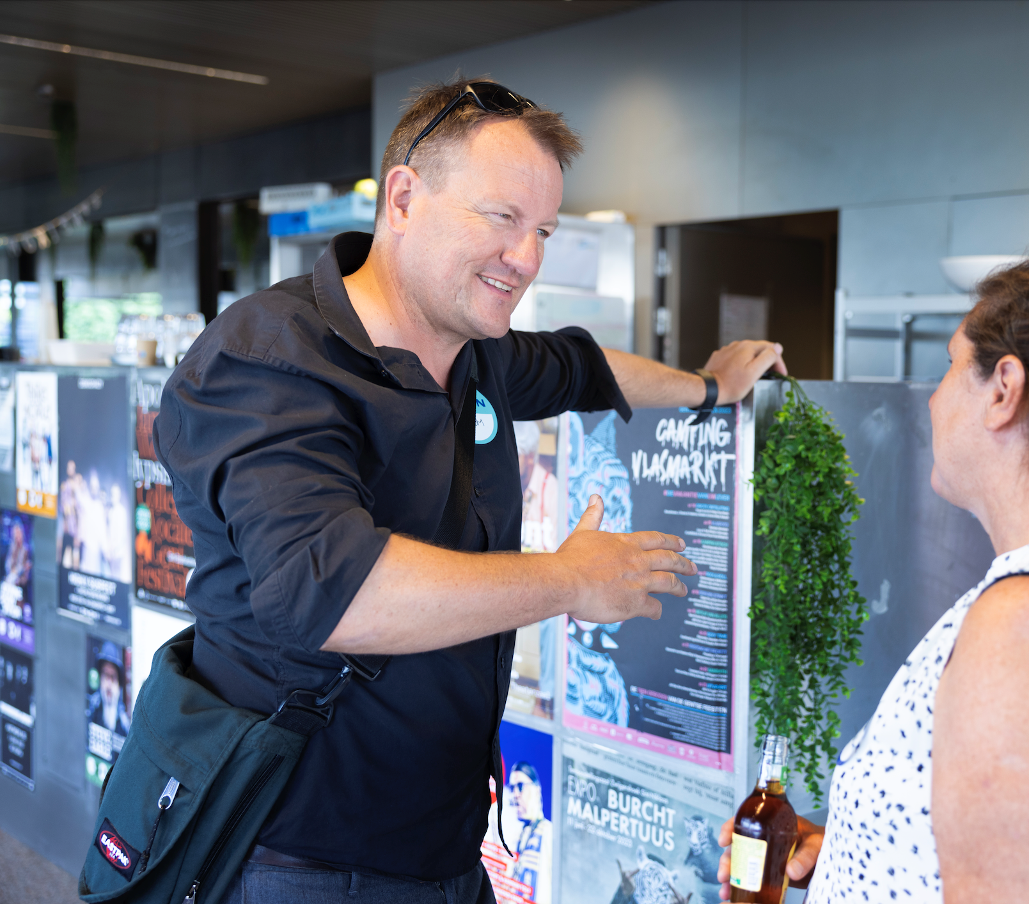
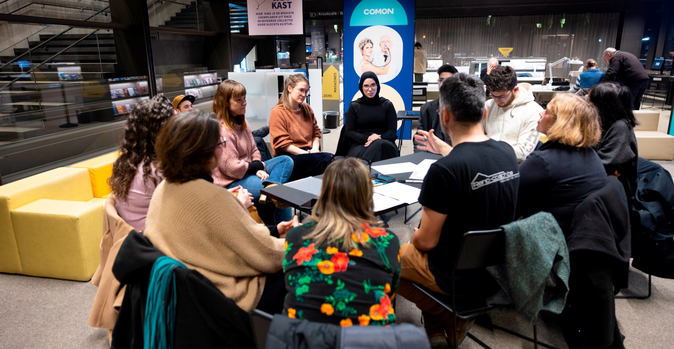
Positive
Advantages for policy makers
Together we can do more
R&D, citizen participation, sensitization
Unexpected encounters
Match making and networking
Notes:
Voorbeeld Els Lecompte: “We hebben maar voetjes onder de tafel te schuiven…”

Slide 95
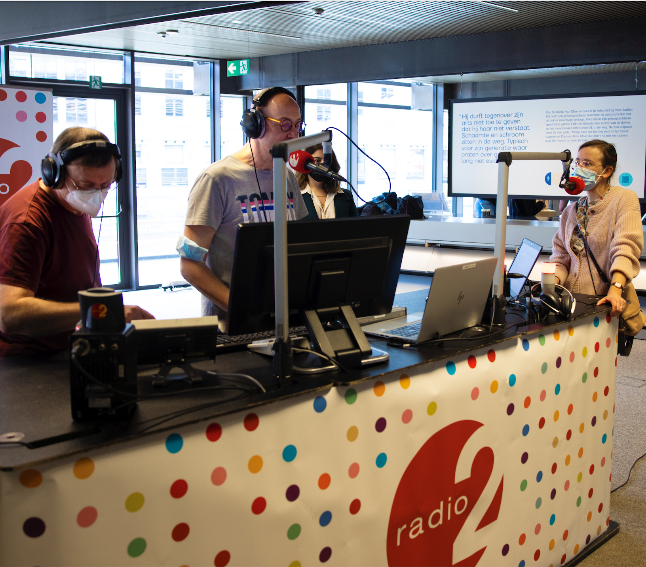

Positive
Advantages for policy makers
Together we can do more
R&D, citizen participation, sensitization
Unexpected encounters
Match making and networking
Visibility
Prizes, publications…

Slide 96
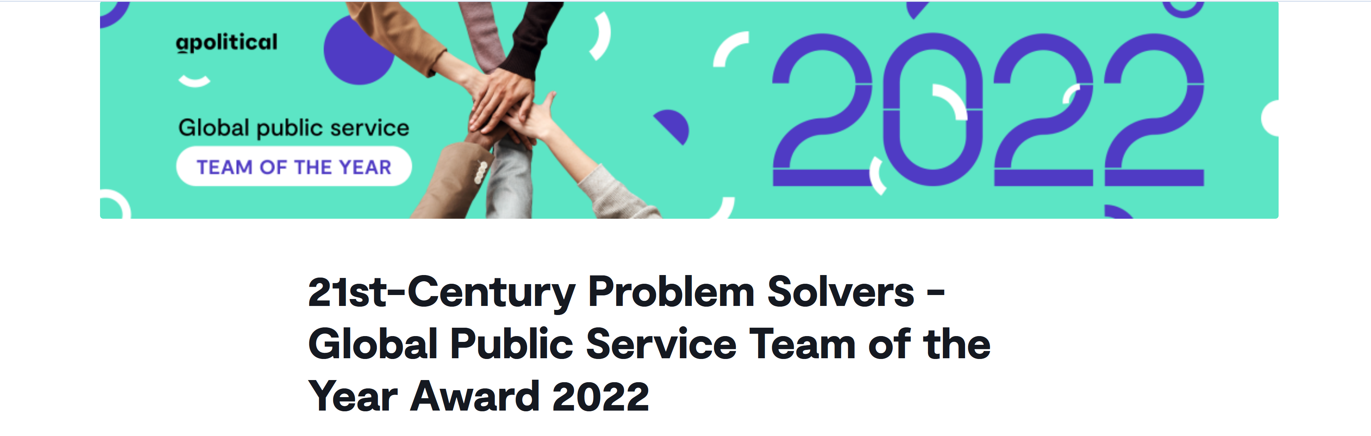
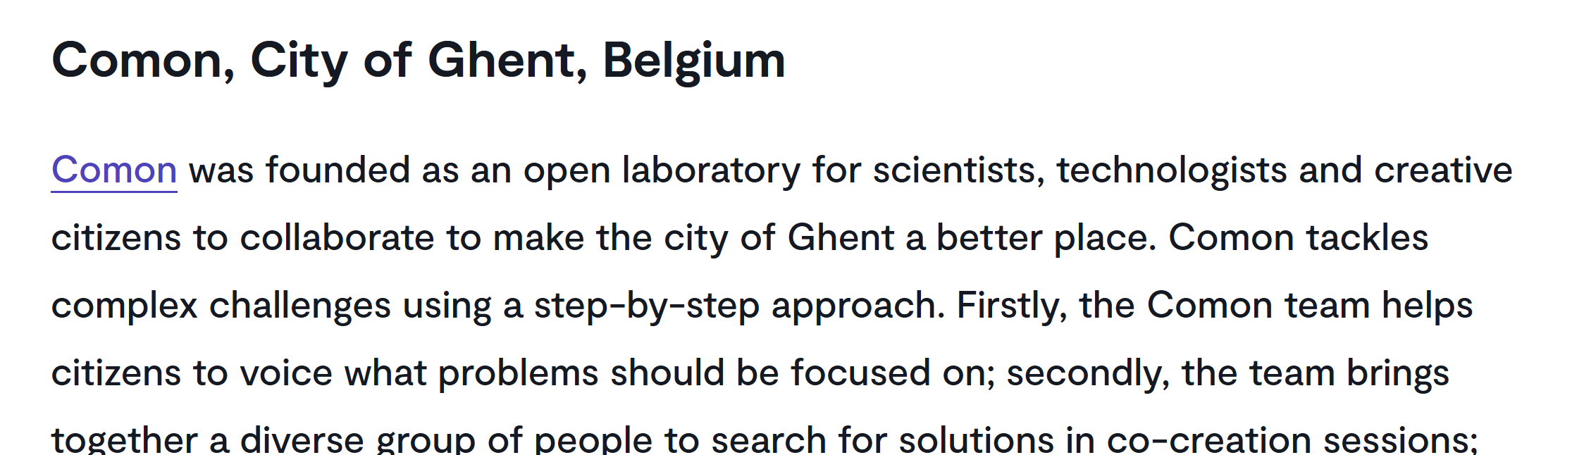

Slide 97
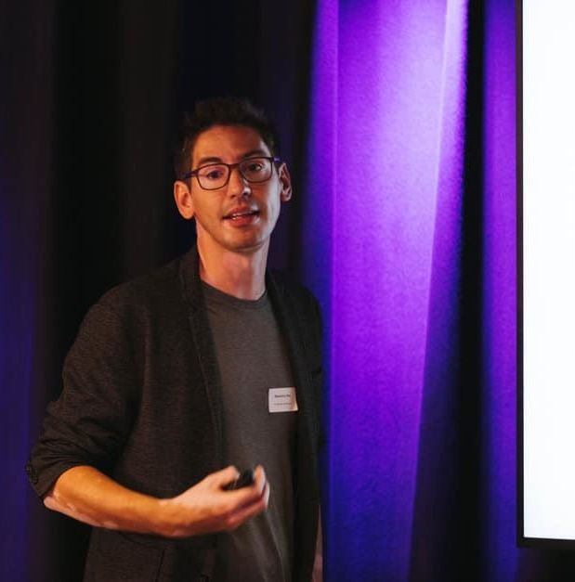
Lessons
Any advice from us?
Growth scenario
From small projects to structural

Slide 98
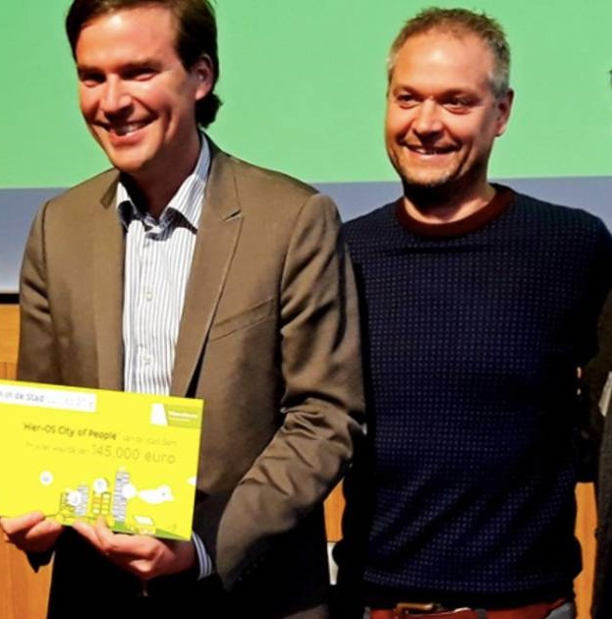
Lessons
Any advice from us?
Growth scenario
From small projects to structural

Slide 99
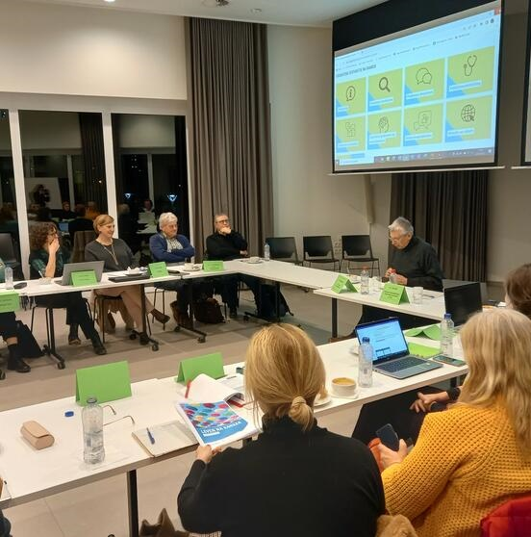
Lessons
Any advice from us?
Growth scenario
From small projects to structural
What’s in it for them
Durable cooperation

Slide 100

Lessons
Any advice from us?
Growth scenario
From small projects to structural
What’s in it for them
Durable cooperation
It’s my job
Don’t just stick to your job description

Slide 101

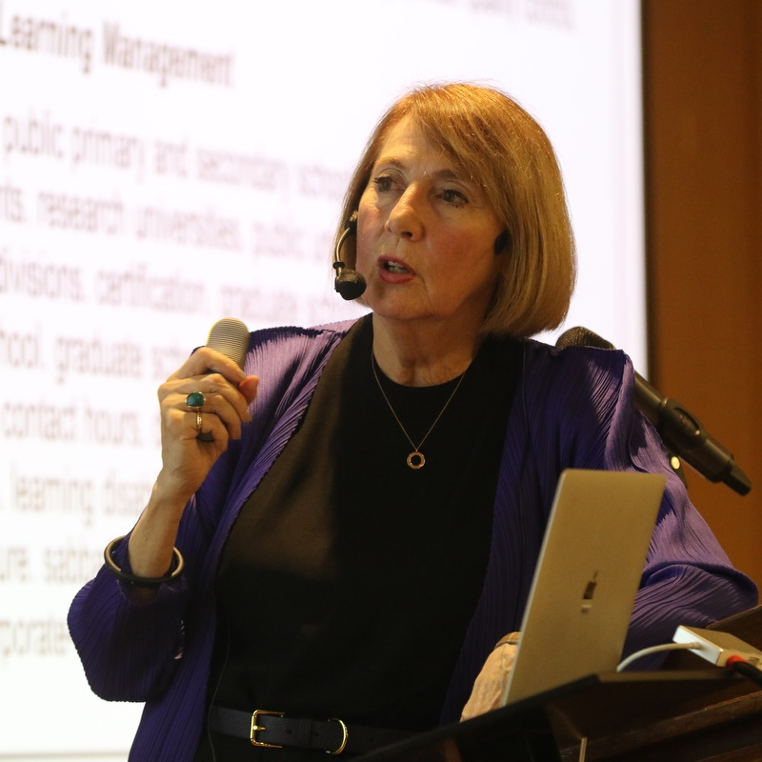
How do you take what is happening in the perifery of many universities and make it more central?
- Cathy Davidson
Notes:
Cathy Davidson
The New Education (How to revolutionize the university to prepare students for a world in flux)

Slide 102
Chief Coordinator of the Science Advice Initiative of Finland
Jaakko Kuosmanen
Small-scale pilots than scaling up tested solutions: Finland notably is very good at this at all levels of government

Slide 103
President of the French Foresight Society, President of Foundation 2100
Jean-Eric Aubert
Foresight exercises and the role of SSAH in a science for policy ecosystem
Notes:
Approved for publishing

Slide 104
SSAH and the Future of Evidence-Informed Policy-Making
Brussels, May 6-7, 2024
Jean-Eric Aubert
Société Française de Prospective
Fondation 2100
2 slides
Presentation of the two organisations
SWOT of FORESIGHT/FUTURE STUDIES

Slide 105
Two Foresight Organisations
Société Française de Prospective
French Foresight Society
Fondation 2100
2100 Foundation
Created in 2013 (assoc. 1901)
About 60 members (including 5 institutions)
Study-oriented: conferences, publications
(Sector) topics: Foresight of work, the enterprise, the environment, territories…
https://www.societefrancaisedeprospective.fr
Established in 2016, under the aegis of CNRS Foundation
Issued from Prospective 2100 (1995-2015 – 150 conferences)
Action-oriented: awards (Ph. D Thesis), competitions, policy notes
Joint work with SFdP : New Narrative(s) for the 21st century
https://2100.org

Slide 106
STRENGHTS -- (VISION) 360° systemic/holistic views Unique instrument for societal dialogue Science + Art | WEAKNESSES -- (KNOWLEDGE) Insufficient analyses of the “future” (often too superficial) Methodological divergences (from SF to forecasts) (Almost) no academic status
OPPORTUNITIES -- (PRESSURE) Ecological/energy transitions Technological, (geo) political…disruptions IA/big data | THREATS -- (POWER) Power arrogance Institutional games and silos Short-termism

Slide 107
Secretary general of Science Europe
Lidia Borell-Damian
The assets of SSAH for the future in evidence-informed policymaking
Notes:
Approved for publishing

Slide 108
The assets of SSAH for the future in evidence-informed policymaking
Lidia Borrell-Damian, Secretary general
session on Innovation in Evidence-informed policy making (EIPM) ecosystems: the added value of SSAH
Part of the 2024 Belgian presidency conference on
#StrongerTogether: SSAH and the future of evidence-informed policymaking
Tervueren, Belgium
07 may 2024

Slide 109
About science europe

Slide 110

Foundation for Science and Technology, Portugal
SELECTED ACTIONS
Thematic R&I Agendas co-designed with experts and companies to identify national challenges, aligning research & policy priorities in selected areas
Multi-actor protocols to facilitate the regular exchange of information, knowledge and priorities in the areas of social sciences, with a specific call for public policy studies, a call for PhD fellowships directed to, among others, public administrations.
Prizes to reward researchers engaged in science for policy activities
(E.g., the prize “Impact of Science on Economy and Society in Portugal”).

Slide 111

What is Science Europe?
Our mission is to define and advocate long-term perspectives for European research and champion best-practice approaches, promoting high quality science for the benefit of humanity and the planet.
Science Europe is the European association representing the interests of major
  public research performing (RPOs) and
  research funding organisations (RFOs)
  that foster excellent, ground-breaking research in Europe.
Science Europe is a research policy organisation; it has no research funding or performing role.

Slide 112
The importance of the arts, social sciences and humanities disciplines
Outcomes of Arts, Social Sciences and Humanities (ASSH) research are natural assets for science-informed policy making, on an equal basis as those from Science, Technology, Engineering and Mathematics (STEM) disciplines.
Outcomes of multi-, inter- and trans-disciplinary ASSH-STEM research foster better informed policy decision-making through a thorough understanding of the interactions between facts, values, identities, collective and individual experiences, and beliefs.
Including ASSH and STEM disciplines from the outset of R&I projects can help to develop a new perspective on impact, less focused on economic, short-term results, but more on transformative changes and shift in values, which can be beneficial when assessing impact of public policies for the common good.
An example of evidence-based policy making on European level are the revisions of the SET plan, which have been concretely involving SSH in defining needs and challenges for EU energy policy.

Slide 113
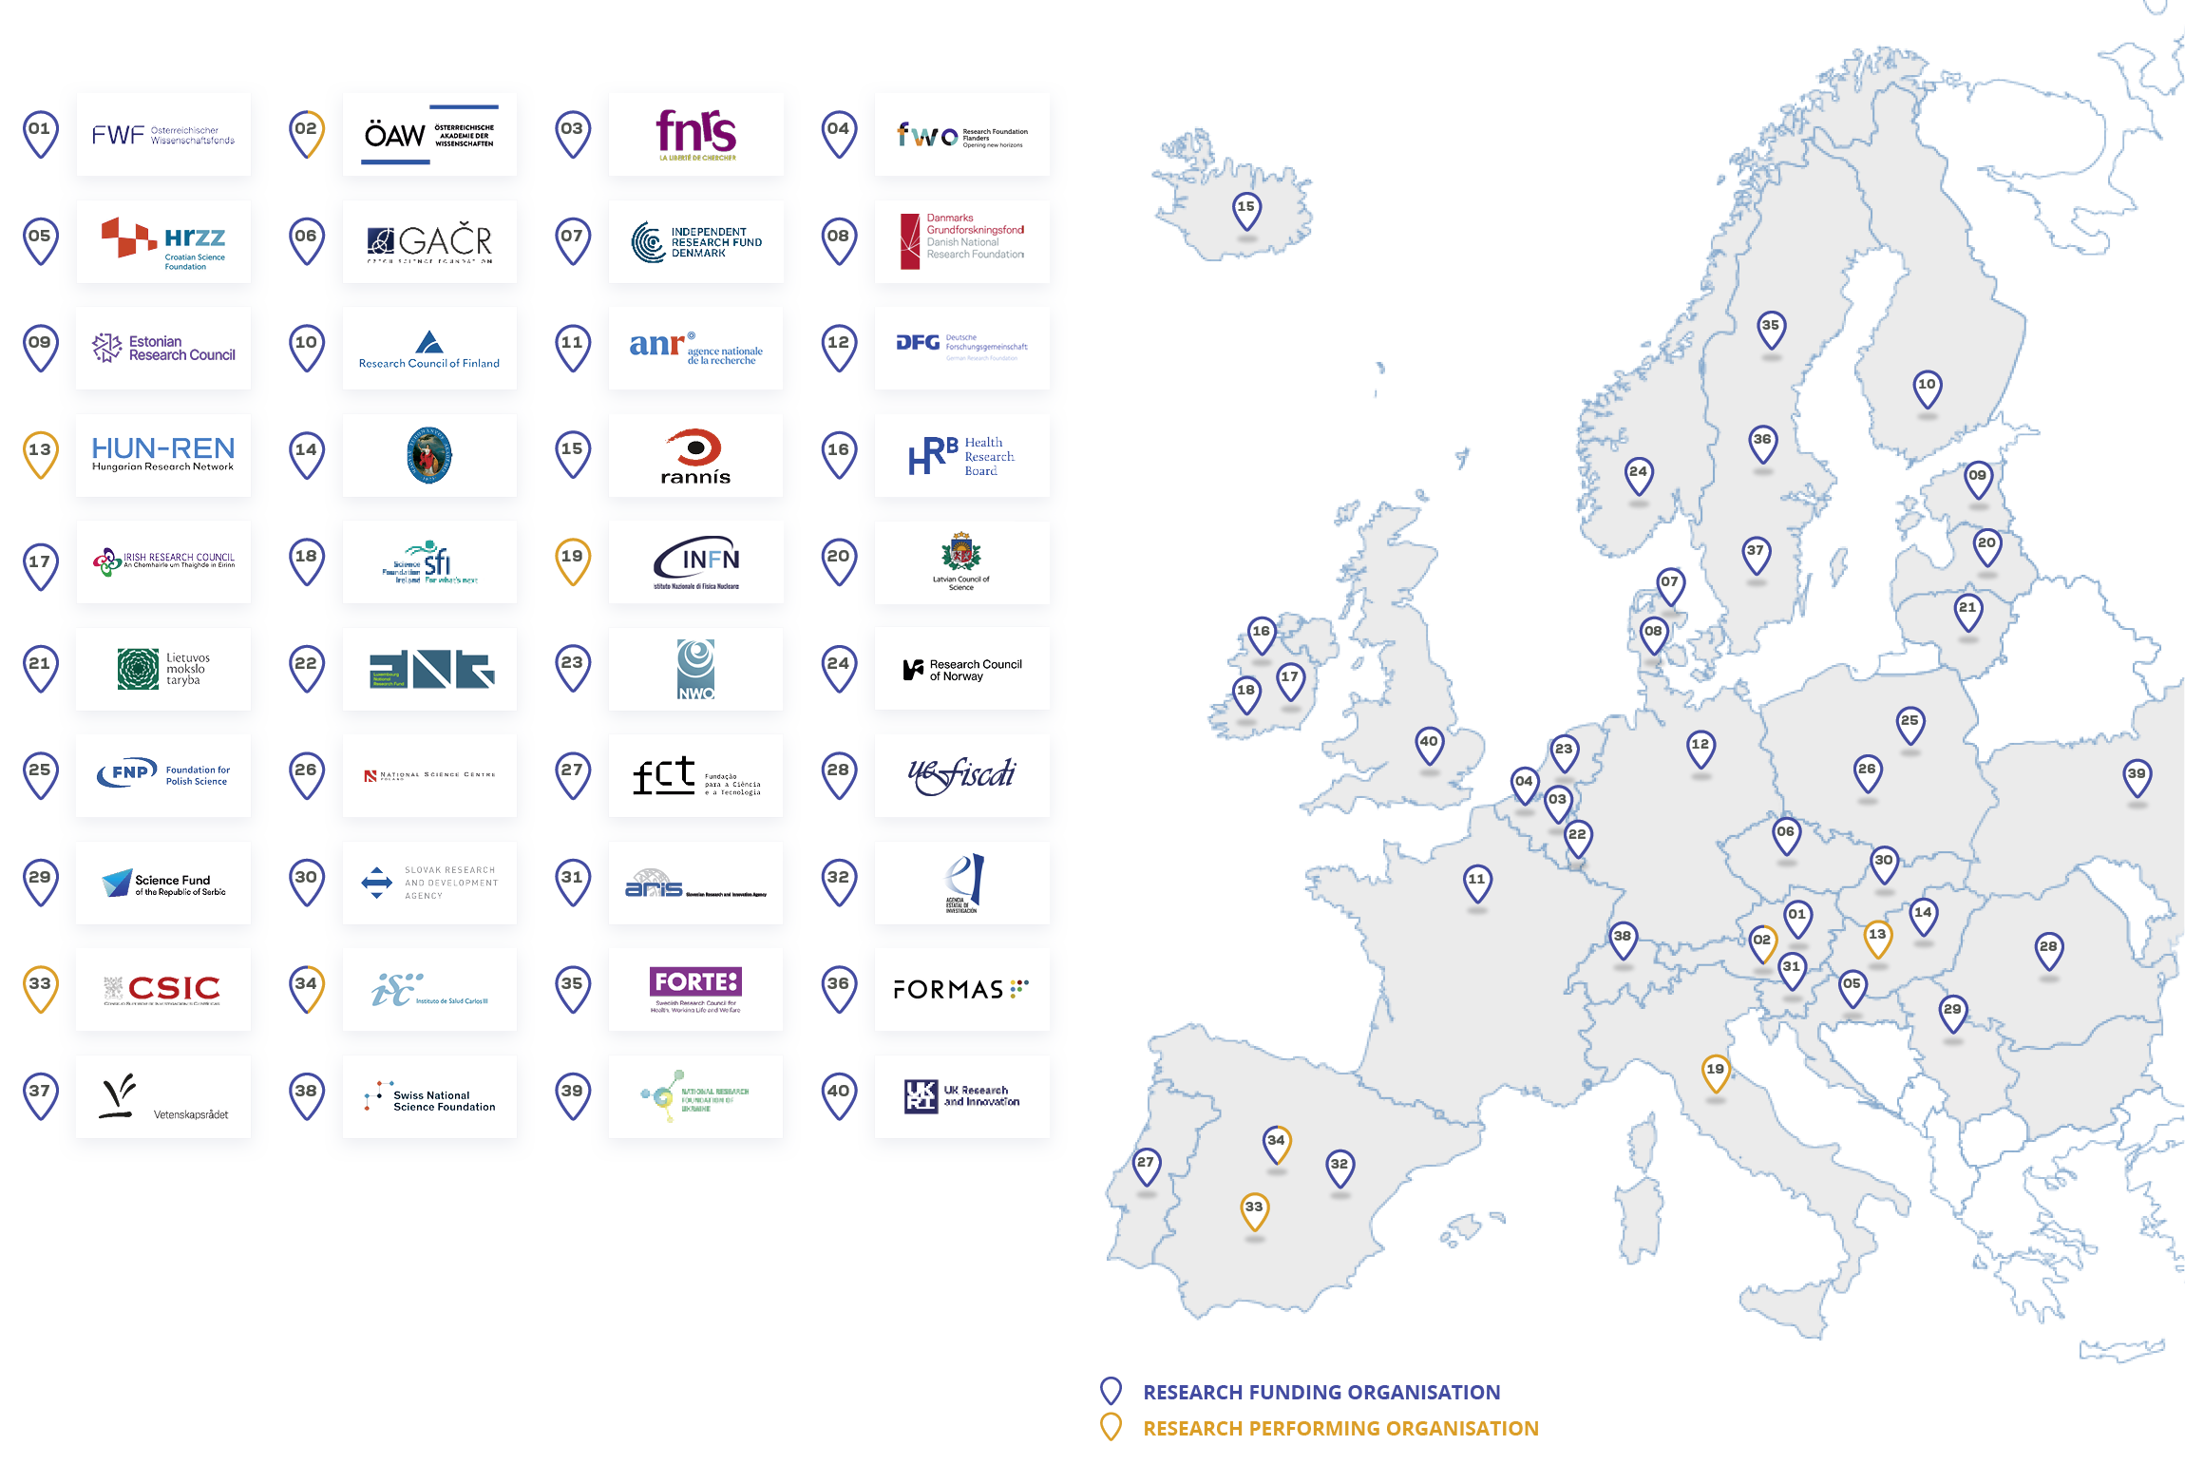
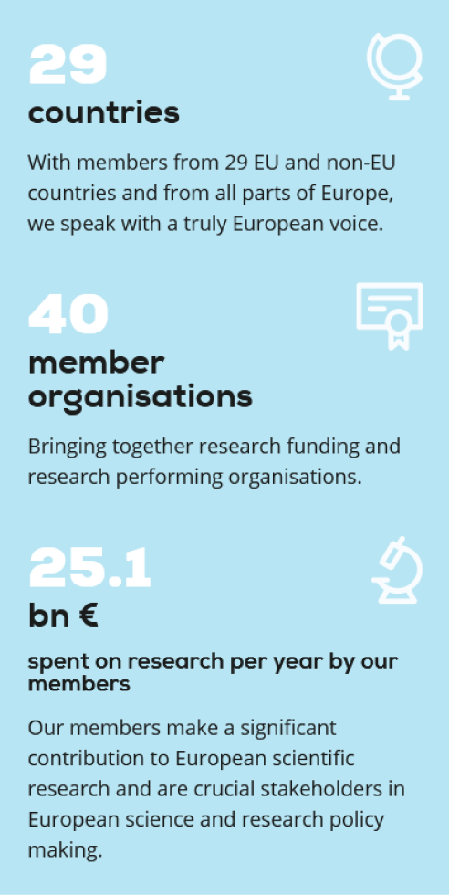
Science Europe Member organisations
Science Europe is the association representing national public organisations that fund and perform research in Europe.

Slide 114
Key factors on science for policy activities

Slide 115

Recent knowledge provided by science Europe members
A 2023 SURVEY-BASED REPORT IDENTIFIES SCIENCE EUROPE’S MEMBERS ACTIVITIES FOR SCIENCE-INFORMED POLICYMAKING
KEY MESSAGES
Recognise, assess, and support ‘Science For Policy’ (S4P) activities
Develop strategies with long-term vision, resources, expertise, data and methods.
S4P activities are relevant in all fields and for all types of policymaking and scientific disciplines.
Trust and mutual respect between researchers and policymakers are crucial

Slide 116




Principles and Values
INSTITUTIONAL MANDATE
  Need an explicit institutional mandate given by policy makers to a dedicated body, properly recognised by the scientific and policy community.
QUALITY, INTEGRITY, TRANSPARENCY
  Research activities need to explain their process of gathering scientific contributions transparently. The official mandate must ensure the highest quality and scientific integrity, while relying on the clear commitment and engagement of both researchers and policy makers.
RESOURCES
  The mandate for Science for Policy activities needs to be associated with dedicated resources, including qualified personnel, sufficient funding, and adequate organisational settings.
OPTIONS, MORE THAN ADVICE
  Science for Policy activities should aim to contribute to policy making as ‘one of the sources’ for decision makers. These activities should present scientific and evidence-based options, rather than prescriptive recommendations.

Slide 117

We consider scientific knowledge to be for the common good and that research is a public service.
We value and protect the freedom of scientific inquiry and the self-organising nature of the scientific research system.
We acknowledge the responsibility of all actors in ensuring the highest possible standards of quality, ethics, integrity, inclusivity, and openness in the conduct and management of research.
We recognise the strong links between research, education, and innovation.
We believe that collaboration within the R&I system and engagement with and for society are constitutive elements of science.
The members of Science Europe defined these values believe in the sharing of good practices as a way to advance research policy and advocacy.

Slide 118
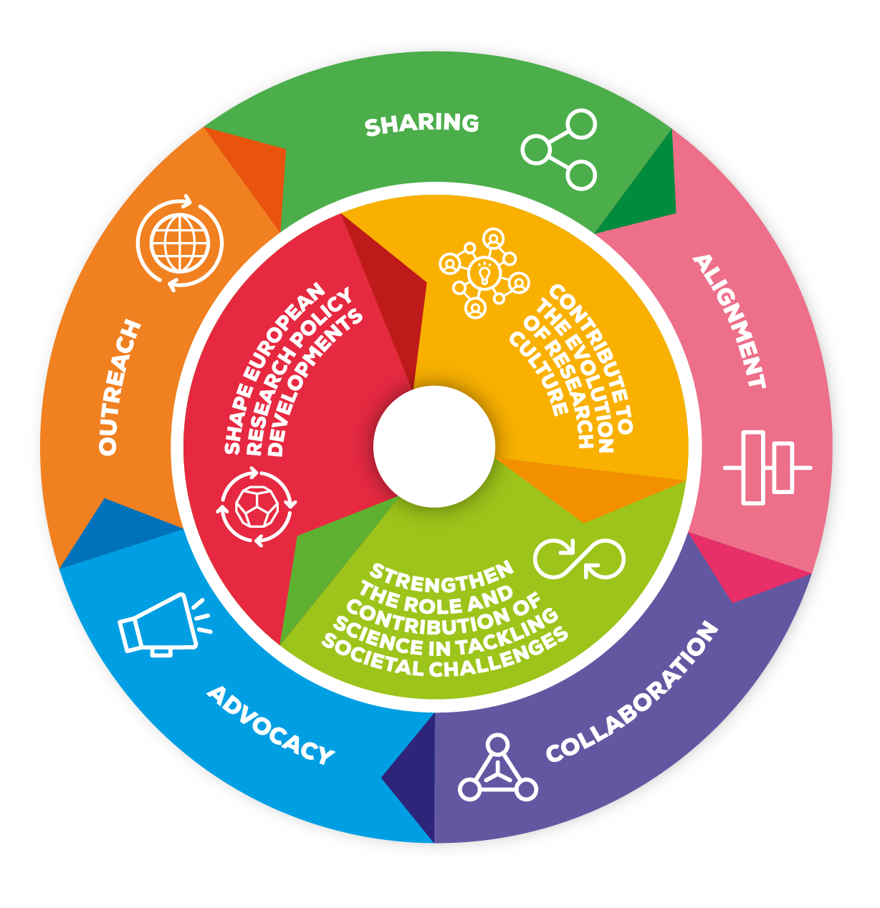



Three Strategic priorities and five purposes
Strategy and multiannual action plan 2021–2026
Shape European research policy development
Contribute to the evolution of research culture
Strengthen the role and contribution of science in tackling societal challenges
https://scieur.org/strategy
https://scieur.org/maap

Slide 119
Context conditions for evidence-informed policy making (EIPM)
Geopolitical, environmental, human rights challenges need solutions stemming from an interdisciplinary agenda, as they encompasses a wide variety of factors which cannot be analysed separately.
Science-informed and evidence-based policy making requires interdisciplinary and systemic approaches to assess different options, overcome personal biases and, ultimately, improve the way societal challenges are addressed. For these reasons, Science for Policy activities should always be seen as a collective process aiming to mobilise knowledge to tackle societal challenges.
Research funders and performers can play an important for in supporting evidence-based policy making, by acting as intermediaries in both directions: identifying policy demands and relevant research findings, and then enabling the interplay between science and decision making.
Creating and reinforcing interdisciplinary Science for Policy networks can be an important channel for science communication, and these networks can support, promote and disseminate complex science findings on various topics such as energy, climate, economics etc, and act as crucial knowledge for transformative change.

Slide 120





Context conditions for evidence-informed policy making (EIPM)
SCIENTIFIC RESEARCH CAN AND SHOULD SUPPORT POLICYMAKERS
IN NAVIGATING COMPLEX, KNOWLEDGE-DEMANDING CHALLENGES
Bi-directional exchanges
A longstanding, complex relationship
Science is back crucial for decision-makers in turbulent times of fake news and misinformation
Several initiatives to improve science-policy ecosystems, in Europe and globally. E.G. EU Council Conclusions 8 December 2023
Emergence of Artificial Intelligence

Slide 121
Principles and Values for science for policy activities
INSTITUTIONAL MANDATE
QUALITY, INTEGRITY, TRANSPARENCY
RESOURCES
OPTIONS, MORE THAN ADVICE

Slide 122
EXAMPLES from science Europe member organisations

Slide 123

Health Research Board, Ireland
A long-term and well-advanced strategy for S4P activities, promoting engagement on policy and research sides
Building in-house capacity, investing in long-term research support and working with policymakers to identify key questions
See the HRB Evidence Centre conducting annual evidence reviews, focusing on policy questions from the Irish ministry for health
Encouraging researcher engagement
Compiling impactful insights
Spotlighting emerging trends
Facilitating knowledge translation
Enabling research-policy exchanges
Navigating complexity with evidence
Investing in evidence synthesis capacity
Empowering trials and multicentre studies
Monitoring long-term trends
Strengthening data infrastructure

Slide 124

Spanish National Research Council
A statutory mandate for S4P activities in Spain in the broad areas of science & technology
An evolving role from pure ‘knowledge generator’ to integrate the role of ‘knowledge synthetiser’.
An articulated set of instruments
The ‘Science for Public Policy’ collection: 8 reports contributing to defining evidence-informed policies (since June 2023).
The Cicero Itineraries: events where politicians, entrepreneurs and journalists can visit csic labs and learn about specific topics
Support to the Spanish government on emergency action protocol.
Interdisciplinary thematic platforms (PTIs) & the CSIC Hubs gathering different research groups & stakeholders (incl. Public Adm.) addressing societal challenges.

Slide 125

UK Research and Innovation
SELECTED ACTIONS
The “Centre for the Evaluation of Complexity Across the Nexus” (CECAN), funded by UKRI at the Surrey Univ. A pioneer centre testing and promoting innovative policy evaluation approaches and methods through a series of 'real-life' case study projects.
The UKRI-supported RIDE Forum unites 24 public sector bodies to enhance environmental research and innovation by facilitating collaboration, reducing duplication, and informing policymaking effectively.
The UKRI internal systems to scan in-house policy-oriented expertise, including a system of incentives to engage researchers in policymaking.

Slide 126
Bibliographic sources

Slide 127

Swedish research council for sustainable development
The Swedish research council for sustainable development (FORMAS) has the institutional mandate to foster collaborations between researchers and stakeholders.
The Council for Evidence-based Environmental Analysis ensures the alignment between national priorities and research evidence synthesis, offering valuable insights on research evidence and recommendations to the Swedish government, following the guidelines for environmental evidence, detailing the steps to ensure integrity and transparency. The Council also provides socio-economic and cost-effectiveness / cost-benefit analyses. The analysis focuses on pointing out possible alternatives and their implications.
For this mandate, FORMAS has specific financial and staff resources. The syntheses are published and openly available, and are disseminated through seminars, roundtable discussions and other relevant fora.

Slide 128
Bibliographic Sources:
Sources from Science Europe :
Building a scientific narrative on impact and societal value of science, November 2016
Call to action to research organisations for the Net-Zero Transition, SE, CESAER, ISCN, University of Glasgow, November 2021
Response to the Public Consultation on Horizon 2020 and Horizon Europe, Science Europe, February 2023
Science–Policy in Action: Insights for the Green and Digital Transition, Science Europe, March 2023
Interdisciplinarity for the Net-Zero Transition : the perspectives of universities and research organisations, April 2023
Guidance on science policy activities, Science Europe, April 2024

Slide 129
Any questions?
Lidia.Borrell-Damian@scienceeurope.org
https://www.scienceeurope.org/

Slide 130
PBL Netherlands Environmental Assessment Agency
Timo Maas
Co-creating the science to policy interface

Slide 131
Short break
15:15-15:30

Slide 132
Wrap-up
12:10-12:40
15:30-16:30

